Slide 1
Introduction to Harm Reduction and The Works Program
Notes:
S

Slide 2
Introductions
Name
Pronouns Position
Notes:
S

Slide 3
Agenda
Define Harm Reduction
Harm Reduction for substance use
Works Program at Boulder County Public Health
Naloxone Training
Notes:
B

Slide 4
Harm Reduction 101
Notes:
B: What does harm reduction mean to you?

Slide 5
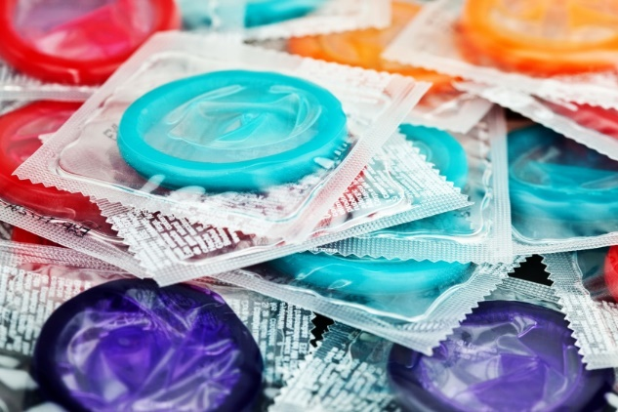
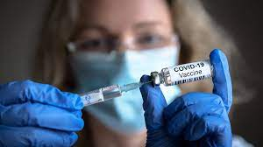
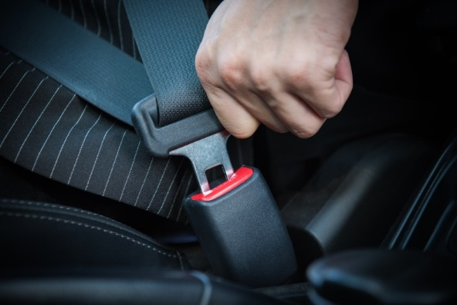
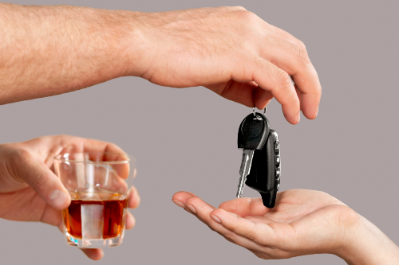
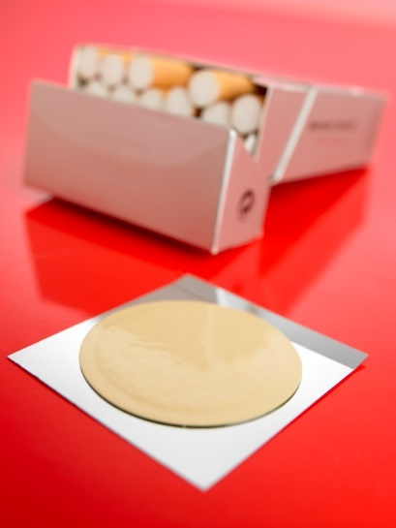
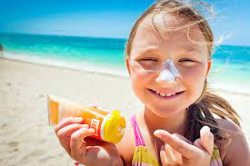
Everyday Examples of Harm Reduction
Notes:
B

Slide 6
Harm Reduction Overview
Harm reduction is a proven public health approach that reduces the adverse health, social and economic outcomes related to a variety of activities.
Harm Reduction reduces harm to the individual, to families, and to the broader community.
Notes:
B

Slide 7
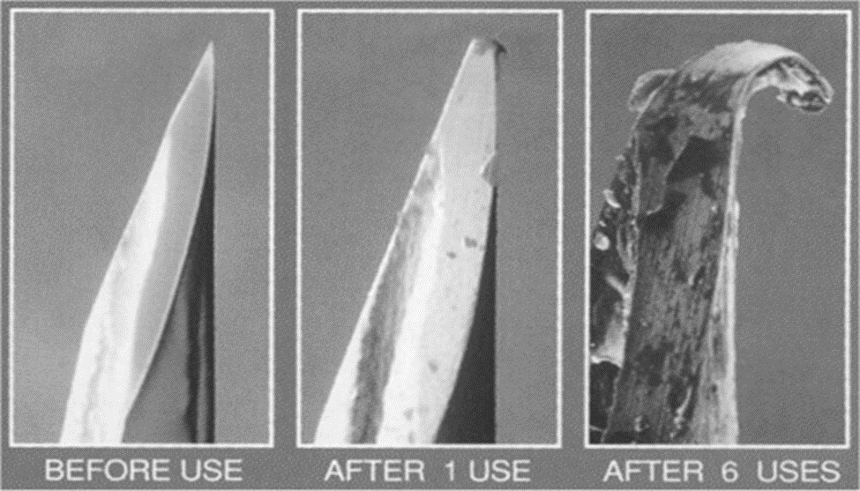
Harm Reduction for People Who Use Drugs
Notes:
S Pix of degradation of a syringe point under a powerful microscope

Slide 8
Harm Reduction for Drug Use
Harm reduction is a set of practical strategies and ideas aimed at reducing negative consequences associated with drug use.
Harm Reduction is also a movement for social justice built on a belief in, and respect for, the rights of people who use drugs.
National Harm Reduction Coalition
Harm Reduction Principles | National Harm Reduction Coalition
Notes:
s Policies, programs and practices that aim to minimize negative health, social and legal impacts associated with drug use, drug policies and drug laws.
Grounded in justice and human rights - it focuses on positive change and on working with people without judgement, coercion, discrimination, or requiring that they stop using drugs as a precondition of support.

Slide 9
National Harm Reduction Efforts
In 2021, the federal Health and Human Services agency released its Overdose Prevention Strategy which promoted harm reduction nationally for the first time by:
increasing the availability and access to high-quality harm reduction services,
decreasing negative effects of substance use, and
reducing stigma related to substance use and overdose
Notes:
S

Slide 10
Harm Reduction Theory
Utilizes a spectrum of strategies
Recognizes that trauma affects behavior
Recognizes that oppression and structural issues affect behavior
Encompasses the harm reduction values of:
Health and Dignity
Participant-
Centered
Participant Leadership
Participant Autonomy
Pragmatism and Realism
Sociocultural Complexity
Notes:
S

Slide 11
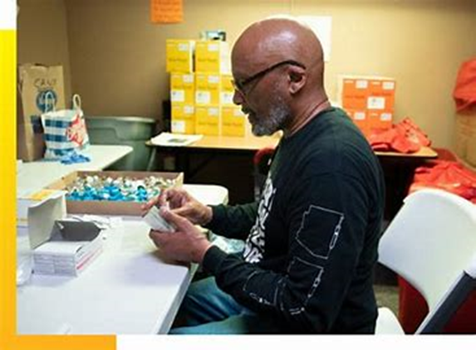
History of Syringe Service Programs (SSPs)
1970s and early 1980s Netherlands in response to HBV
1980s underground SSPs begin to pop up U.S. in response to HIV
1988 First SSP in Tacoma, Washington state, USA
1988 Federal Ban on SSPs in USA
1989 Boulder County SSP established
1992 National Syringe Access Network established
Notes:
B Federal ban on SSPs lifted in 2009. Maia Szalavitz “Undoing Drugs” history of harm reduction great book

Slide 12
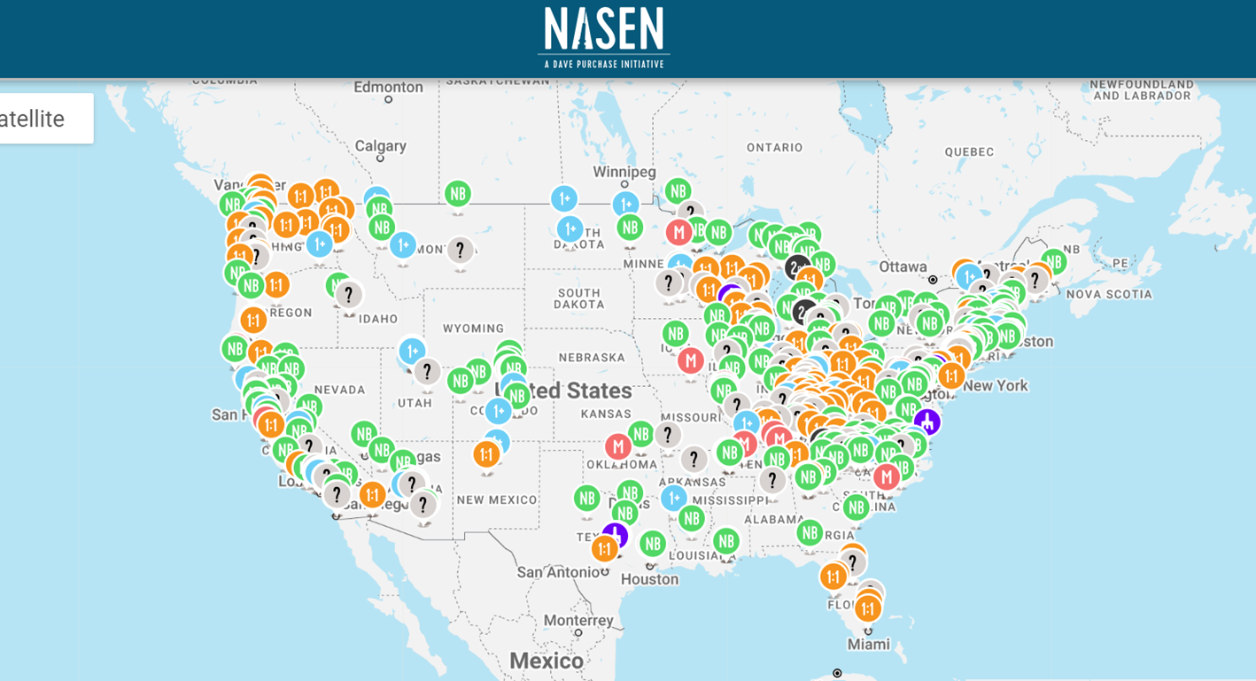
Syringe Exchanges in U.S.
Notes:
B About 300 syringe programs in the USA (Kaiser Family Foundation 2024)

Slide 13
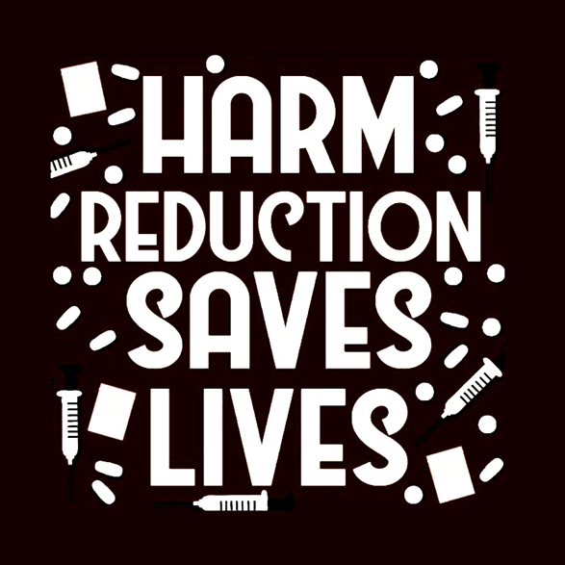
Goal of Harm Reduction
Reduce deaths due to overdose.
Increase connection and break down internal stigma.
Decrease HIV & Viral Hepatitis transmission.
Reduce the risk of soft tissue, blood and other bacterial infections
Improve linkage to community resources
Notes:
B

Slide 14
Evidence for SSPs
People who use syringe access programs are 5 times more likely to enter treatment for substance use disorder and more likely to reduce or stop injecting than PWID who don’t use syringe access programs.
Centers for Disease Control & Prevention, Syringe Service Programs, 2.8.24
Notes:
B

Slide 15
Works Program Evidence
“I was in Utah for 7 years and I was not even treated as a person there and I couldn’t get a HIV test to save my life. The level of guilt and shame I felt made me want to use more.
What I like about Boulder is that it’s out in the open, I don’t have to hide. I have a safe place to go to. The more face to face time I get with people like you [the Works team members] and link with services, it helps to reduce my usage.
I have lost all relationships and been to dark places I can’t even talk about. I am going into treatment tomorrow.”
- Works Program Participant, Longmont
Notes:
B

Slide 16
Encouraging Connection
“The opposite of addiction isn’t sobriety. It’s connection.” – Johann Hari
- Not “what’s wrong with you?”, but “what’s happened to you?”
- Think of a time you’ve felt shame about something, and kept it a secret…
Notes:
S

Slide 17
Use Person-First Language
Potentially Stigmatizing Language
Addict / junkie
Drug dealer
Substance abuse
Clean
Replacement/ substitution therapy
More Compassionate Language
Person who uses drugs
Person who sells drugs
Substance use
Person changing their drug use / abstaining from substance use
Medication for Opioid Use Disorders / Medication for Addiction Treatment
Notes:
S

Slide 18
Works Program
Notes:
S

Slide 19
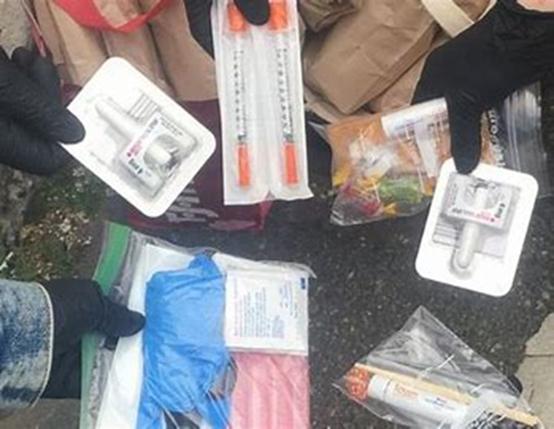
35 Years of Syringe Exchange in Boulder County
The Works program has been operating for 35+ years, and provides:
overdose prevention education and supplies
sterile injection equipment
safer smoking and snorting equipment
vein health and wound care info
HIV and hepatitis C testing
Outreach and community education
referrals for treatment, community and educational resources
participant cards – legal protections
Notes:
S

Slide 20
The Works Program Works!
In 2023, the Works program:
Served 1,747 unique individuals in 7,603 separate encounters
Provided 341,242 sterile syringes
Collected 138,781 used syringes
Distributed 27,302 pipes
Distributed 4,373 naloxone kits
Had 76 successful overdose reversals reported to staff
Provided 6,502 fentanyl test strips
Performed 78 HIV tests and 74 HCV tests
Notes:
S

Slide 21
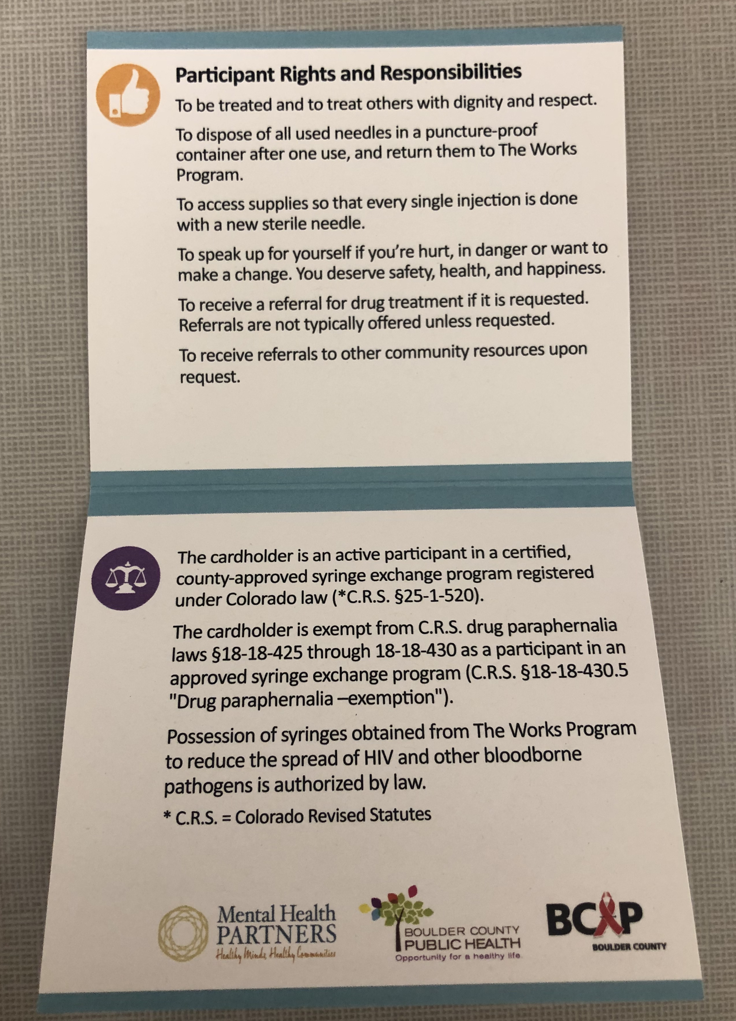
Works Program Cards
Notes:
B

Slide 22
Local and State Laws
Our participants are in a county-approved, certified syringe exchange program registered under Colorado law (CRS 25-1-520).
Our participants are exempt from the CRS drug paraphernalia laws 18-18-425 through 18-18-430 when carrying their Works Program card.
A person is immune from criminal prosecution for administering Naloxone, to another person whom the person believes to be suffering an opiate-related drug overdose (CRS 18-1-712).
Notes:
B

Slide 23
Local and State Laws (cont’d)
An opiate antagonist (e.g.: Naloxone) may be prescribed and/or dispensed (Naloxone Standing Orders) for purpose of treating individuals who may experience an opiate-related drug overdose event (CRS 12-36-117.7).
A participant is immune from criminal prosecution when they report an emergency drug or alcohol overdose. This same immunity applies to persons who remain at the scene of the event until a law enforcement or EMS arrives. The immunity described above also extends to the person who suffered the emergency drug or alcohol overdose event. (C.R.S. §18-1-711)
Notes:
B

Slide 24
Naloxone and Opioid Overdose Response
Notes:
S

Slide 25
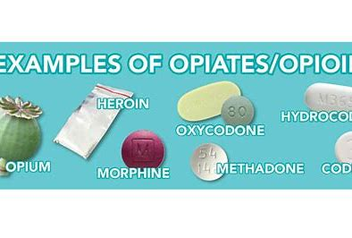
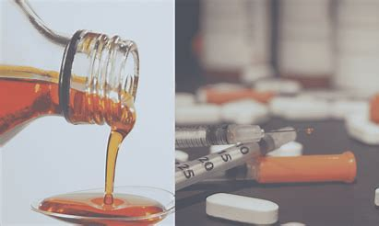
What are opioids?
Heroin
Fentanyl (Rx or illicitly manufactured)
Hydrocodone (Vicodin®, Norco®)
Oxycodone (Percocet®, OxyContin®)
Codeine (Tylenol® with codeine)
Hydromorphone (Dilaudid®)
Oxymorphone (Opana®)
Methadone (Dolophine®, Methadose®)
Buprenorphine (Suboxone®, Subutex®, Butrans®)
Notes:
S

Slide 26
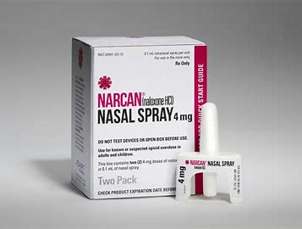
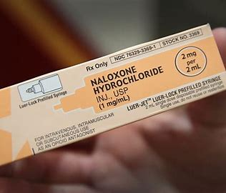
What is Naloxone?
Naloxone is a safe medication that can reverse an opioid overdose.
It is safe to use naloxone even if you do not know what drugs someone used and/or if they have mixed drugs.
Notes:
S

Slide 27
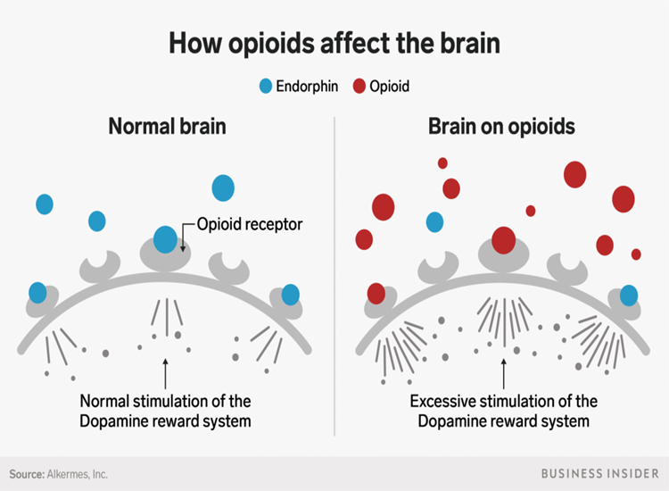
What is an opioid overdose?
All opioids put people at risk of an overdose.
Opioid receptors in the brain become blocked by an influx of opioids.
Breathing and heart rate slow down and might stop, causing the overdose.
Notes:
S

Slide 28
What increases the risk of an overdose?
Decreased tolerance
Any period of non-use
Mixing opioids with other substances
Alcohol or benzodiazepines
Quality and consistency of the drug
Using alone
Lack of access to harm reduction programming
Age and physical health
Mode of administration
Previous non-fatal overdose
Notes:
B

Slide 29
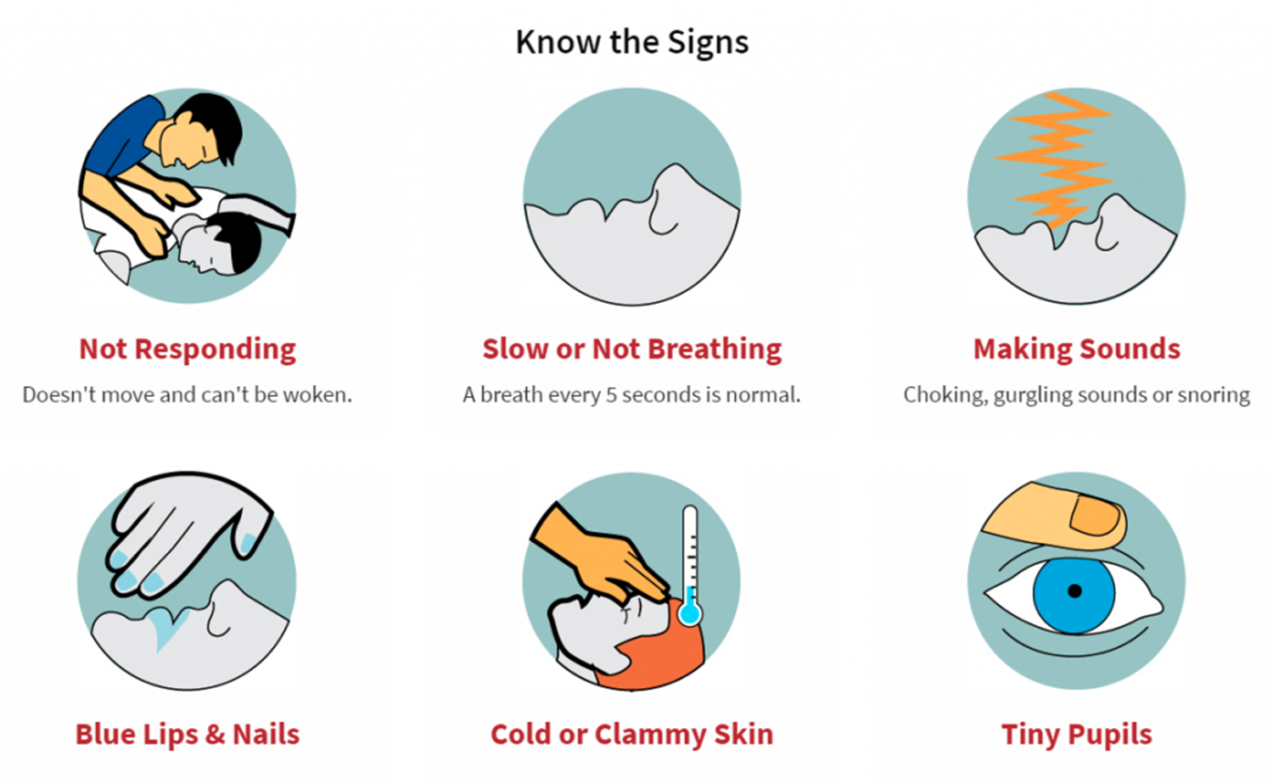
Notes:
B

Slide 30
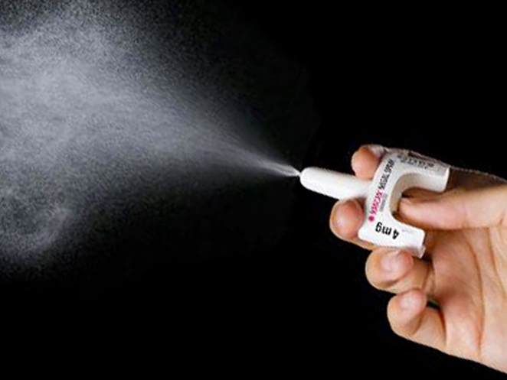
Responding to an overdose
Check for breathing
- If breathing: monitor for changes.
- If breathing is too shallow, slow, or has stopped:
Administer naloxone.
Call 911.
Give rescue breaths.
Notes:
B

Slide 31
Responding to an overdose (cont’d)
After 3 minutes, if there is still no response, give a second dose of naloxone.
Depending on person’s opioid tolerance and unique physiology, more than one dose could be needed (unusual).
Stay with the person until EMS arrives.
Naloxone works for 30-90 minutes and it may cause withdrawal symptoms.
Notes:
S

Slide 32
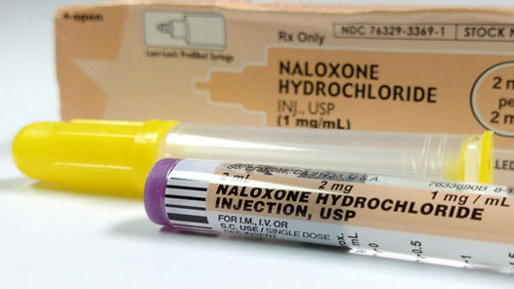
2 mg IM Naloxone is preferred ☺
Follow same steps in OD response
First formulation - before nasal spray!
Pre-loaded muscling syringe
Administered directly into thigh/shoulder
Notes:
S

Slide 33
Responding to an overdose (cont’d)
The focus of overdose response and reversal is BREATHING, not regaining consciousness.
Response to an overdose is meant to occur between the time respirations change (too slow or shallow) but before cardiac arrest.
Notes:
S

Slide 34
Overdose and Fentanyl Myths
There are NO opioids too strong for naloxone to work on
Giving someone more than one dose of naloxone at once will NOT make it work faster (IM is best)
Fentanyl has NOT been found in marijuana
Notes:
B Fentanyl’s boiling point is 870F and most vape pens don’t go over 500F at the HIGH max. Cannabis is typically vaped at 325-430F, and e-juice nicotine is vaped at 350-470F.

Slide 35
Aggression or Anger with Overdose Reversal:
This is a rare event
When it happens it can be due to OVER dosing someone with naloxone – they have been thrown into precipitated withdrawals
We can avoid the likelihood of this event by:
Utilizing lowest dose naloxone possible (IM)
If possible, do not administer naloxone past the point of breathing restoration
Minimizing the number of people (particularly people in uniform) present when/if person becomes completely conscious
Be quiet and gentle and give the person physical space when/if they become fully conscious
Notes:
B

Slide 36
Risk of Unintentional Exposure to Opioids
Overdose can occur in the following ways:
Injecting
Smoking
Snorting
Ingestion
Overdose cannot happen through skin contact or breathing in secondhand smoke.
1. Attaway, P.R., Smiley-McDonald, H.M., Davidson, P.J., and Kral, A.H. (2021). Perceived occupational risk of fentanyl exposure among law enforcement. International Journal of Drug Policy, In Press.
Notes:
B Feldman R, Weston BW. Accidental Occupational Exposure to a Large Volume of Liquid Fentanyl on a Compromised Skin Barrier with No Resultant Effect. Prehosp Disaster Med. 2022 Aug;37(4):550-552. doi: 10.1017/S1049023X22000905. Epub 2022 Jun 20. PMID: 35722948.

Slide 37
Questions
Any further questions, thoughts, ideas?
Evaluation – please let us know your feedback, ideas for follow up training or resources, etc.
Notes:
S

Slide 38
Accessing the Works Program
Boulder County Public Health
515 Coffman, Ste. 200 Longmont M-F 10:30am-4:30pm
1755 S Public Road, Lafayette Thursdays 2pm-5pm
The Works Program - Boulder County
Mental Health Partners
3180 Airport Road, Boulder 24 hours, every day
Boulder County AIDS Project
2118 14th Street, Boulder M-F 2pm-5pm
Notes:
S

Slide 39
Accessing the Works Program
Kelsey Weigman – Harm Reduction Specialist and Case Manager
kweigman@bouldercounty.gov
Madeleine Evanoff – Harm Reduction Specialist
mevanoff@bouldercounty.gov
Karina Ventura – Bilingual Harm Reduction Outreach Educator
kmolfese@bouldercounty.gov
Sean Velazquez – Harm Reduction Specialist: Community Educator/Trainer
svelazquez@bouldercounty.gov
Notes:
S

Slide 40
How can we better work together to serve our community?

