Slide 1
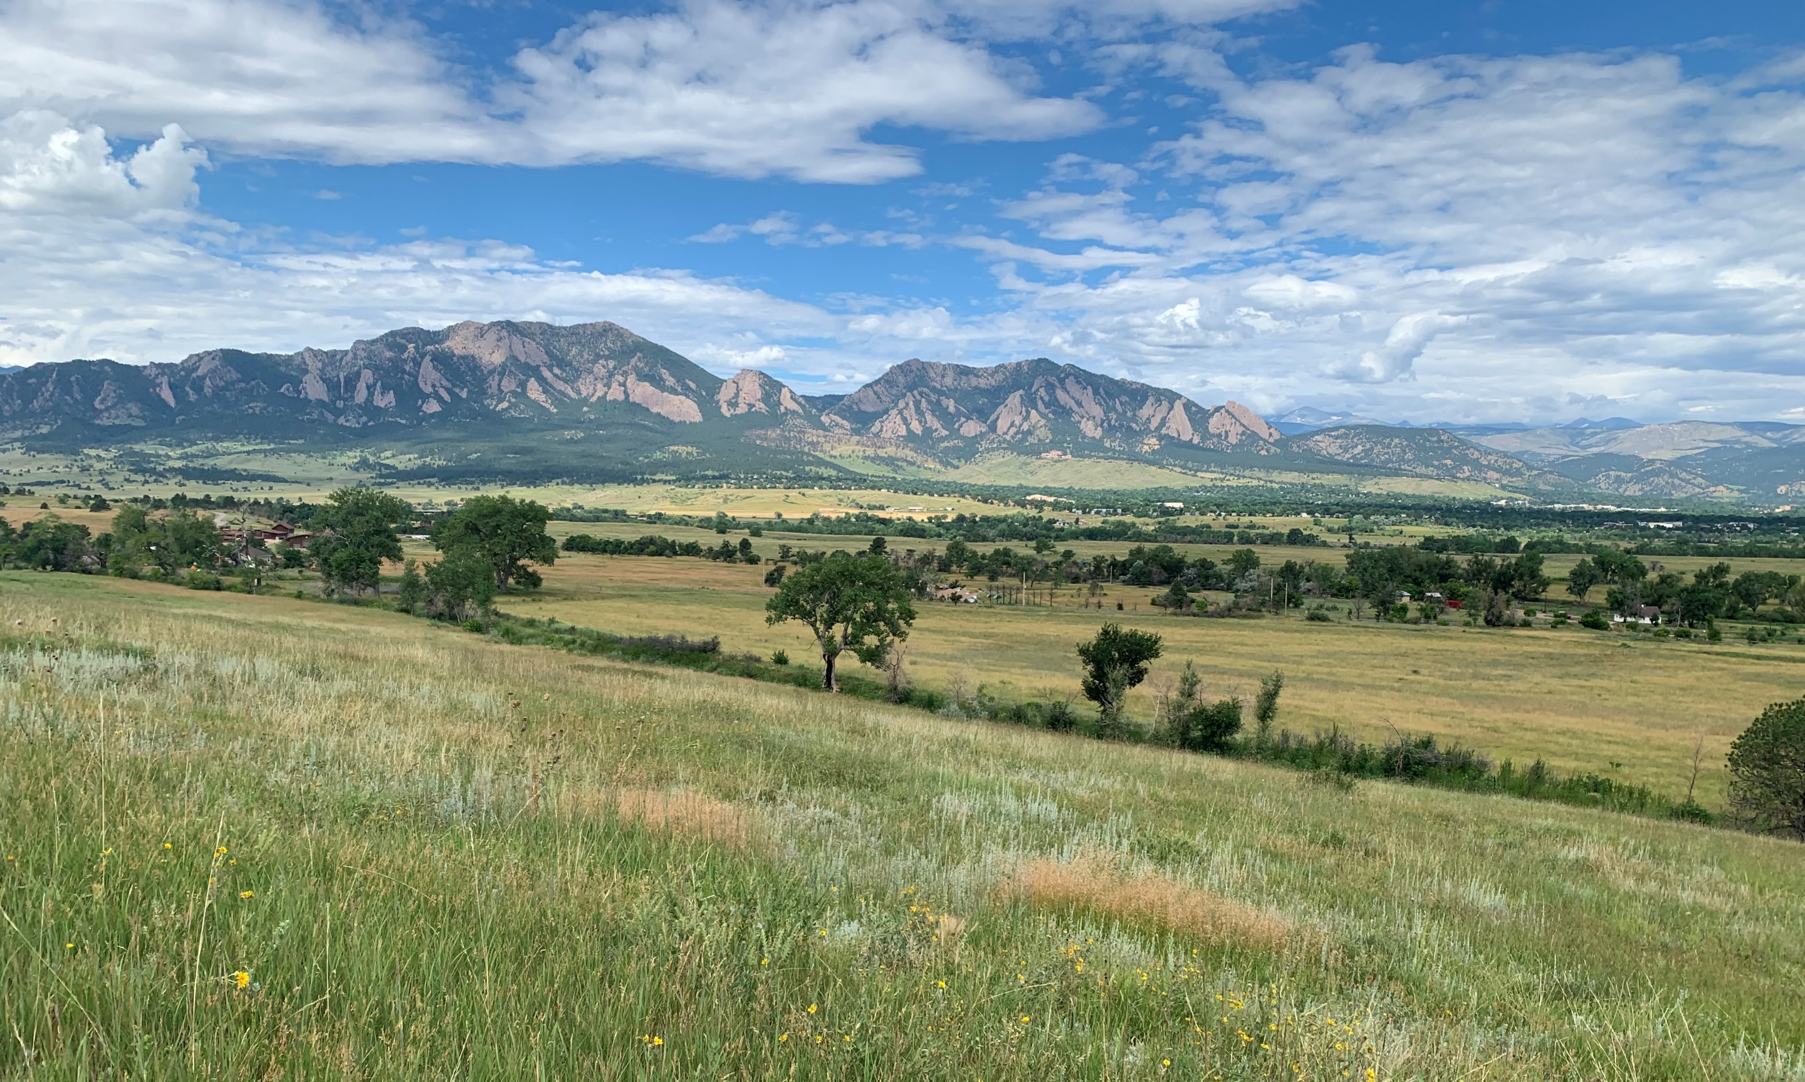
Collaborative Research on Grassland Fuels and Management
Jon Henn, Katie Suding
University of Colorado Boulder

Slide 2
Project Background
Following the Marshall fire, a lot of questions came up about wildfire in grasslands and how we can reduce wildfire risk
However, in attempting to answer these questions, we realized that we know very little about grassland fuels, and the effectiveness of potential fuel management actions

Slide 3
Fuel map example

Slide 4
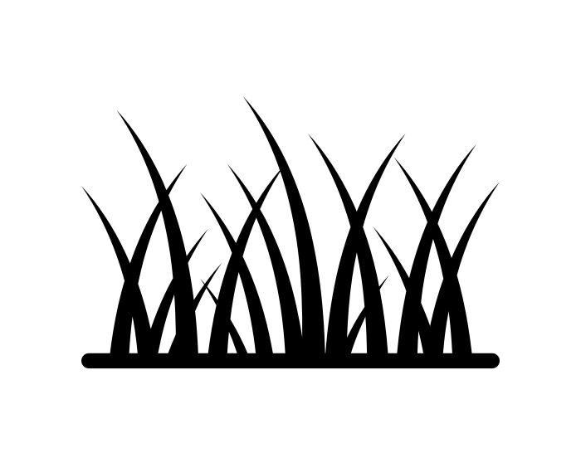
Objectives
Objective 1: Describe Landscape and Seasonal Variation in Grass Fuels
Objective 2: Test Fuel Management
Techniques
Objective 3: Evaluate Scenarios to Determine Landscape-level Fuel Treatment Priority Areas

Slide 5
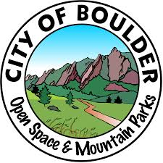

Slide 6
Objective 1: Variation in grassland fuels

Slide 7
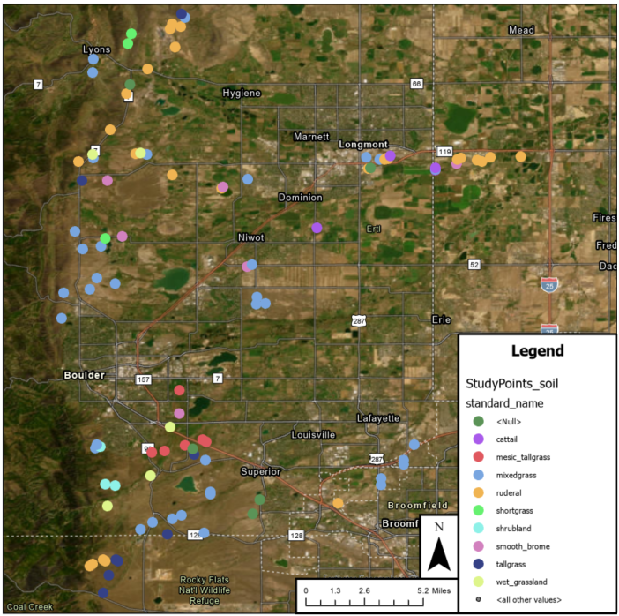
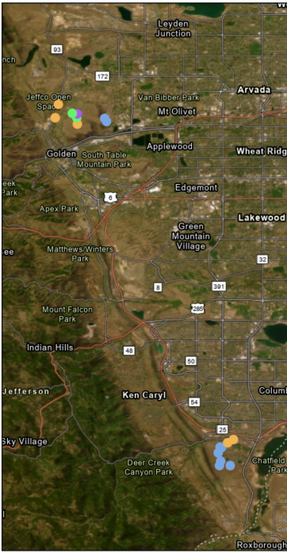

Slide 8
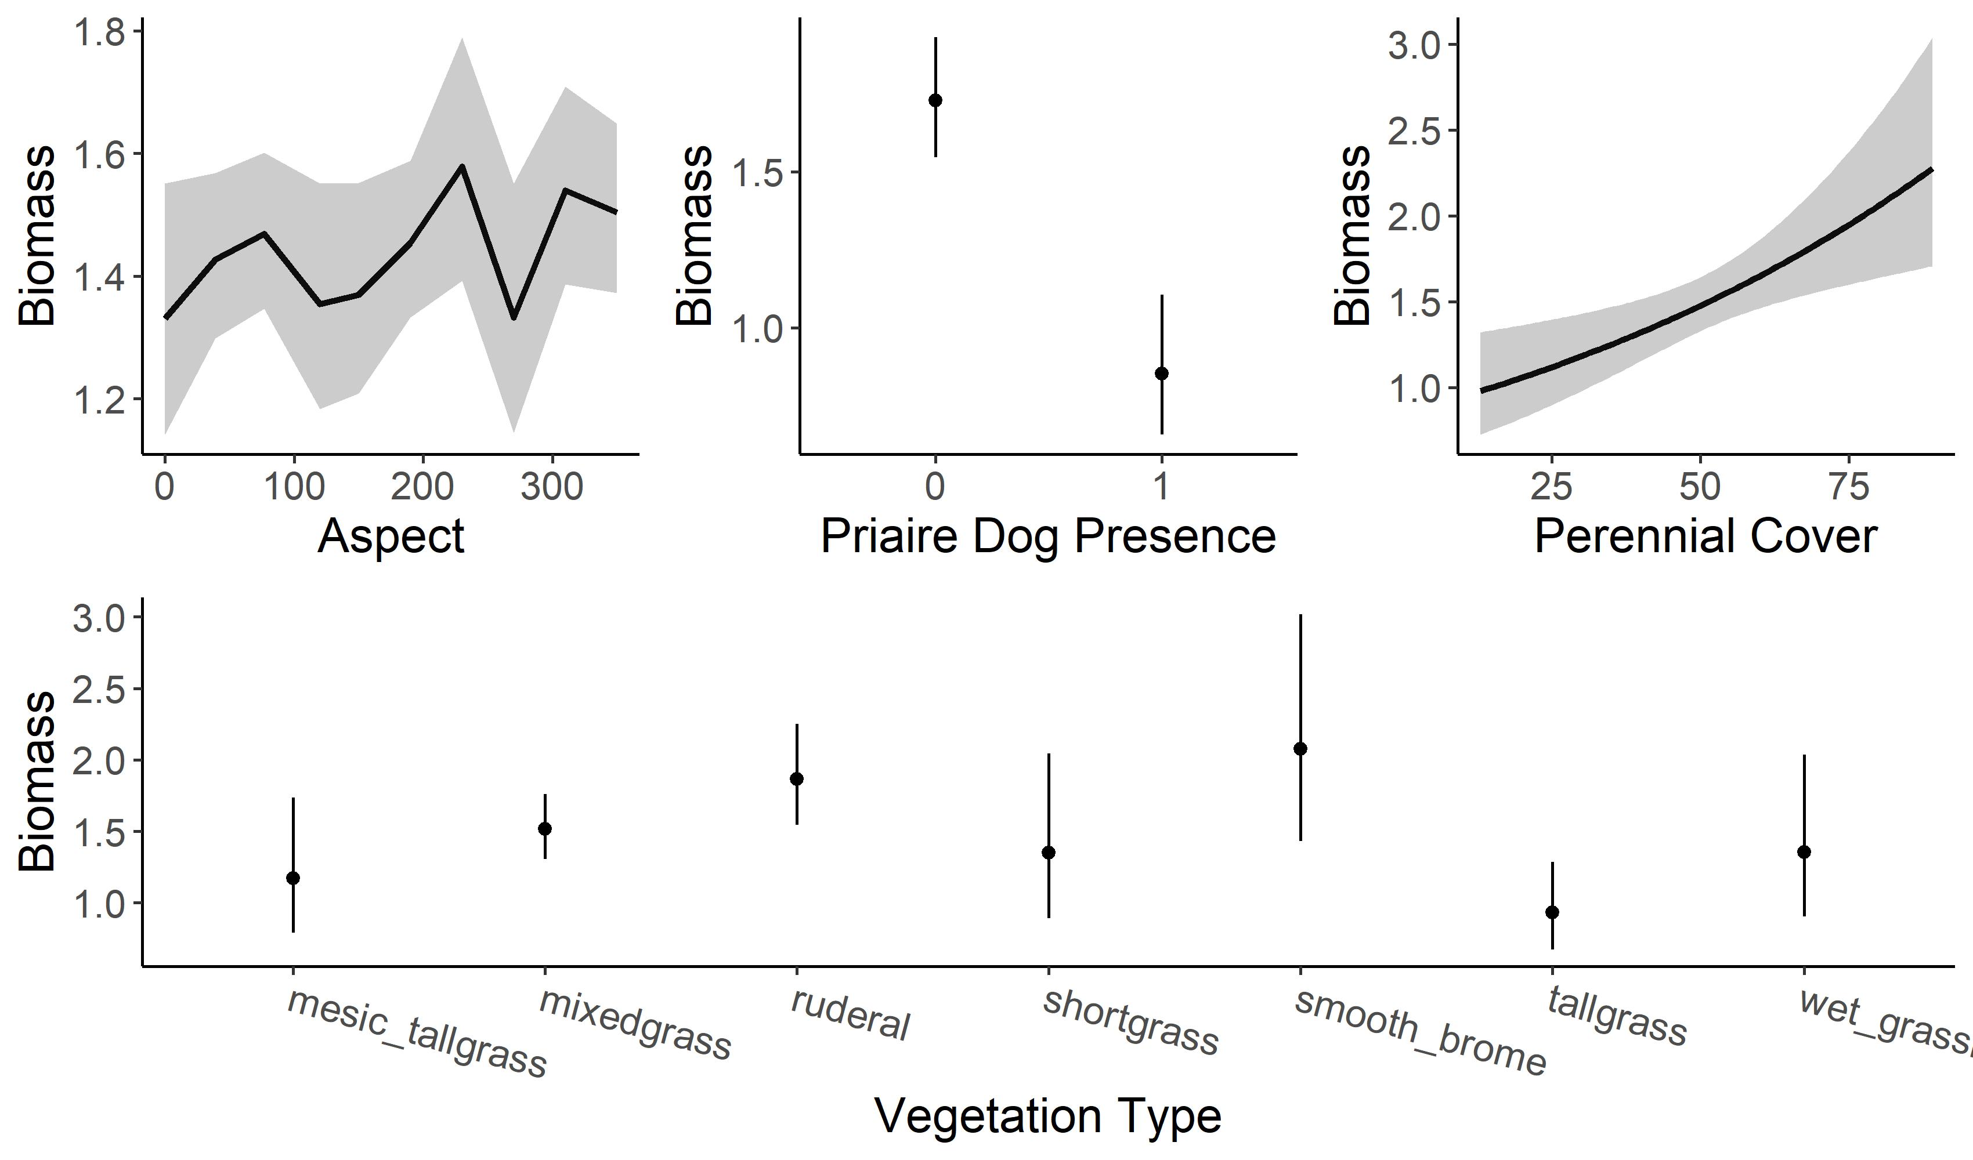
Variation in Fuel Characteristics

Slide 9
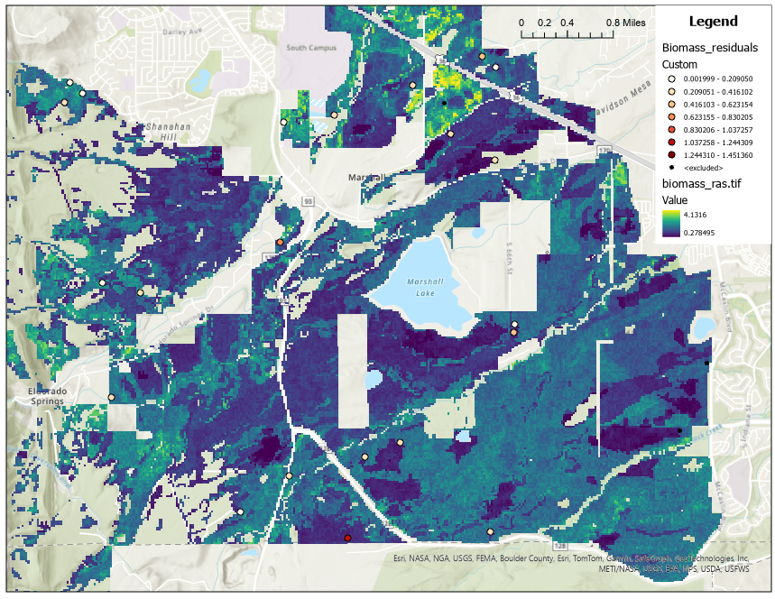

Slide 10
Objective 2: Testing fuel management methods
Distributed experiment at 8 locations
Treatments that we will test:
Mowing
Grazing
Prescribed fire
We will measure how fuel characteristics respond over time
We will also measure effects on other important grassland functions
Plant diversity, native/non-native species
Soil carbon, nutrients, and stability
Forage production and quality

Slide 11
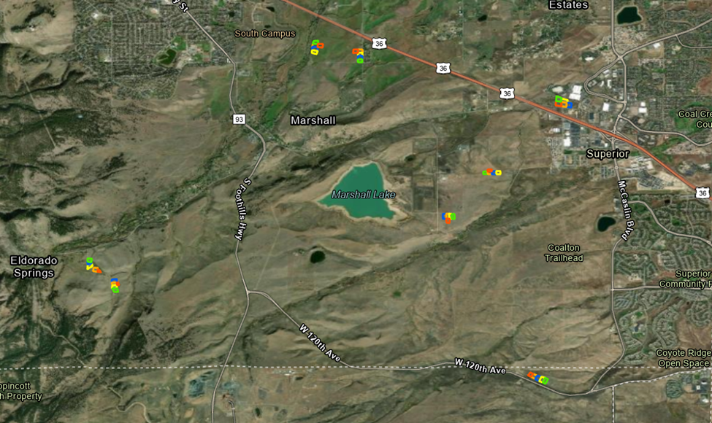

Slide 12
~1 acre
Fuel, vegetation, and soil monitoring plots

Slide 13
Objective 3
Objective 1: Describe Landscape and Seasonal Variation in Grass Fuels
Objective 2: Test Fuel Management
Techniques
Objective 3: Evaluate Scenarios to Determine Landscape-level Fuel Treatment Priority Areas

Slide 14
Thanks! Questions?
More info and updates: https://www.sudinglab.org/fuels
Jon Henn - jonathan.henn@colorado.edu

