Slide 1
Animal Disaster Preparedness
2024

Slide 2
Agenda
Introduction
Pet Preparedness Tips
Grab List
PHaR
Q&A

Slide 3
Virtual House Keeping Items
This webinar will be recorded.
All participants will be muted.
If you have a question, please add it to the chat or wait until the Q&A part of the webinar.
Please be respectful of the audience and presenters.
All content will be shared after the webinar via email and on the City of Louisville website.

Slide 4
Introductions
Kiana Freeman
Recovery & Resilience Manager
David Crawford Co-Founder and Executive Director Animal Help Now

Slide 5
Staying Informed
Sign up for emergency notifications
BOCOAlert & Reachwell
Weather Applications
Preparedness Applications

Slide 6
Everbridge/BOCOALERTS Opt-In Alerts
Types of Alerting
Call
Text
E-mail
Manage your account
Add up to 5 addresses
You will only get notifications for impacted areas near one of the addresses affiliated with your account.
And the most impotant thing: the audience won’t miss the point of your presentation

Slide 7
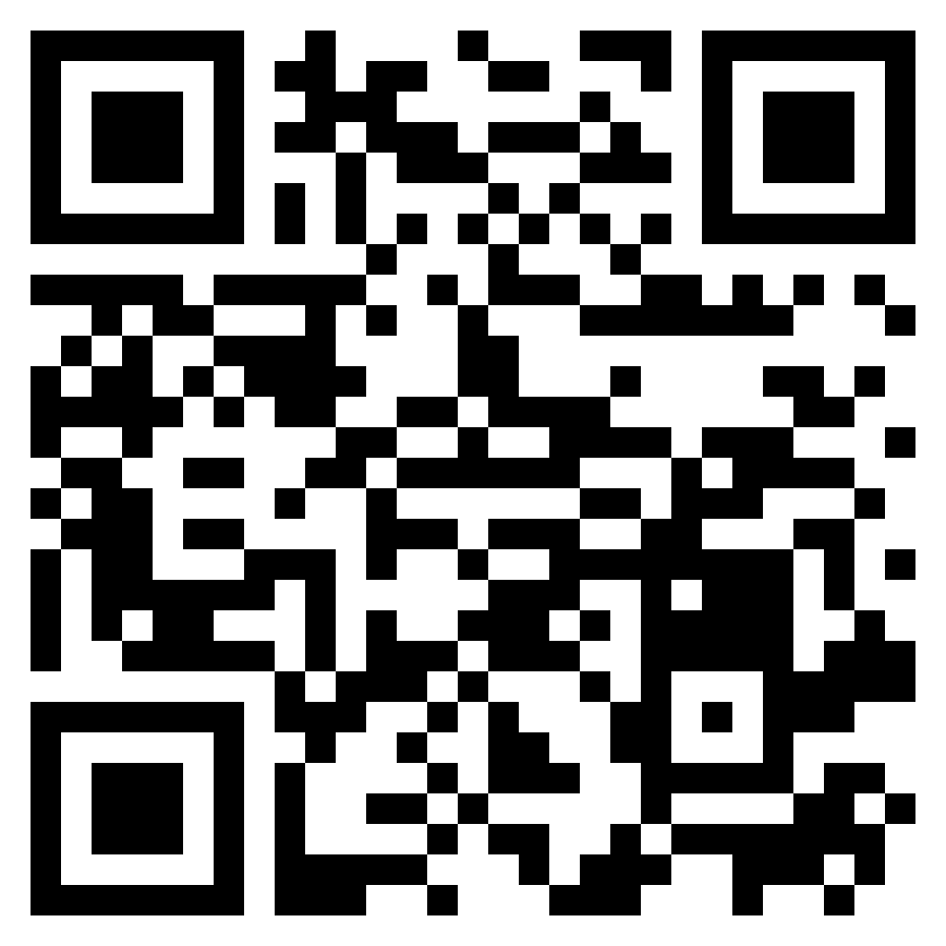
Scan to sign-up, or visit www.BOCOalert.org

Slide 8
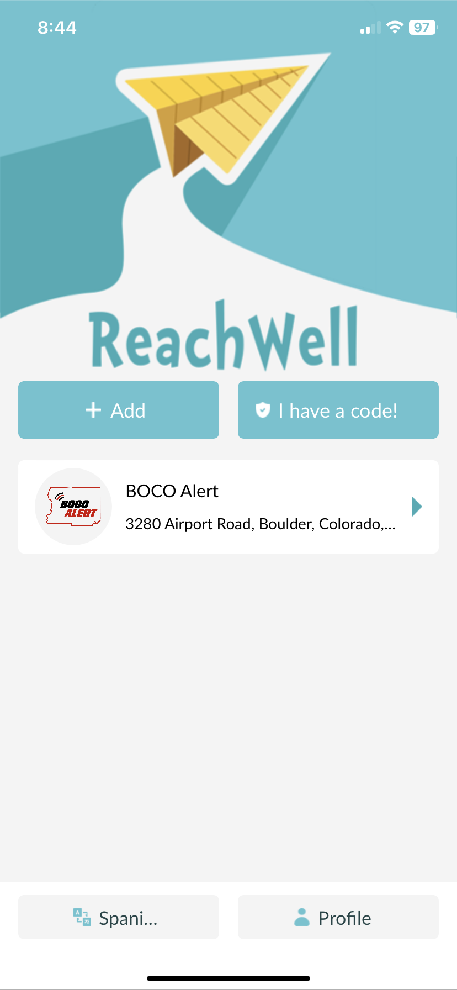
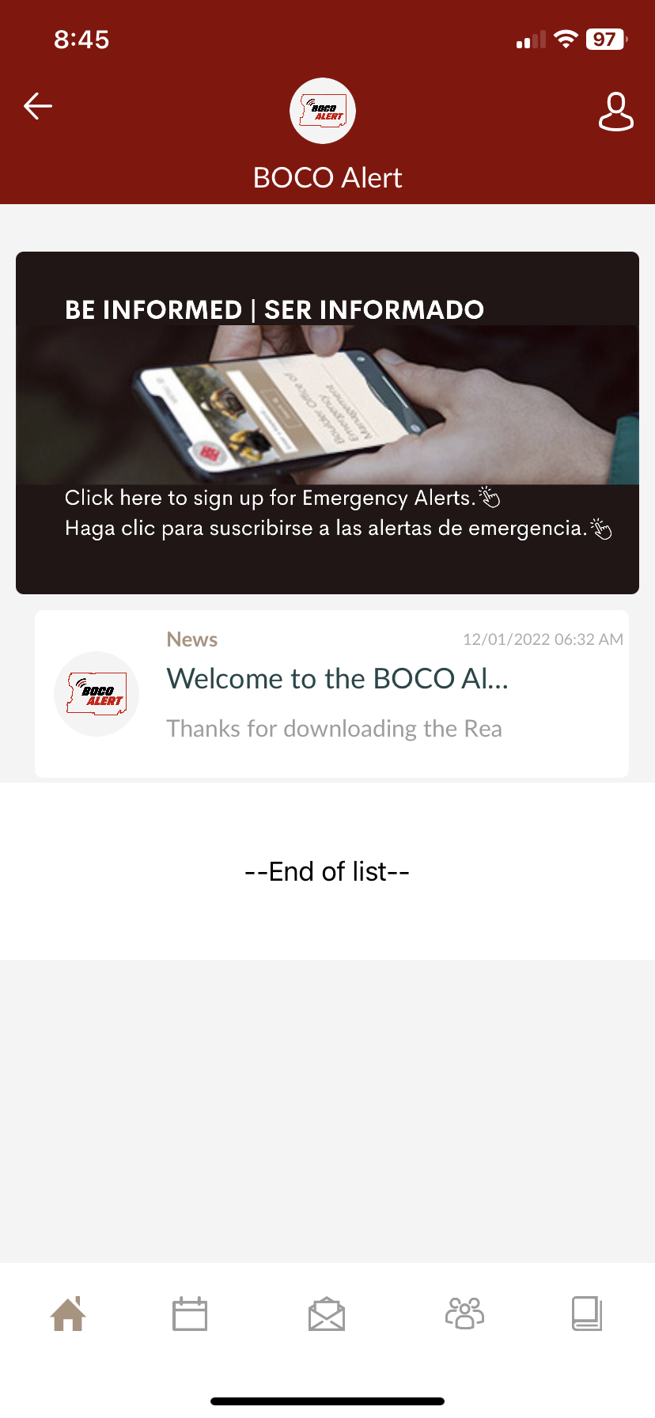
ReachWell Translation App
Phone app
Download, then search for BOCO Alert
Provides alerts in over 100 languages

Slide 9
Scan to download the ReachWell App

Slide 10
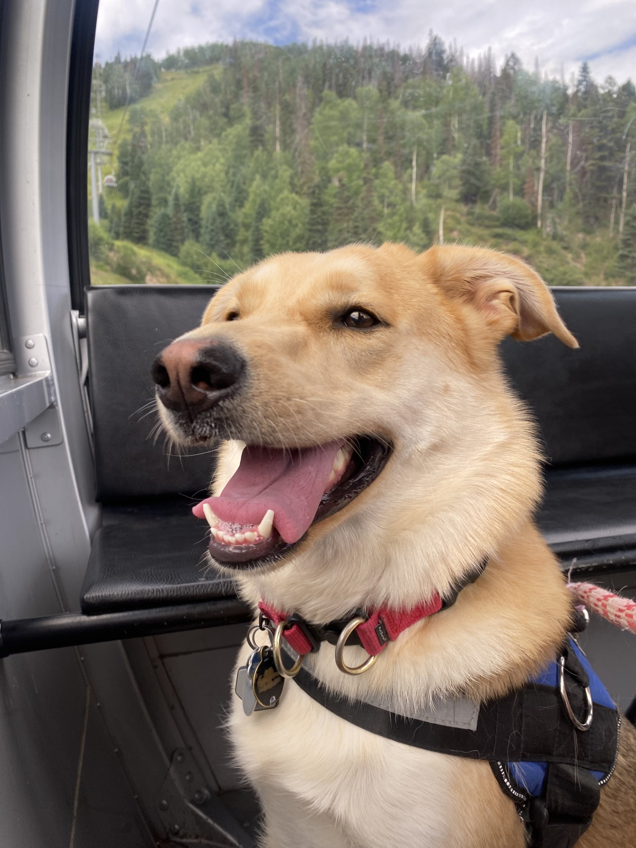
Knowing Your Pets
Behaviors & Reactions
Hiding, Reactive, A Runner, etc.
Anxiety
People, other animals, noises, etc.
Health Concerns
Is there a health concern for your animal?
Are they on medication?
Does something happen when they are stressed?

Slide 11
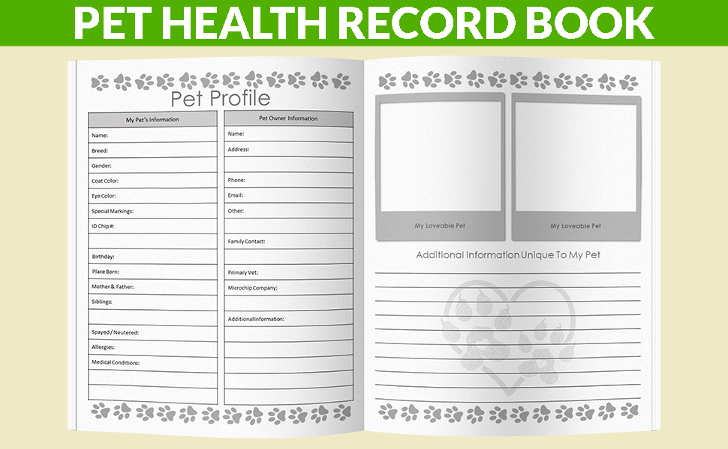
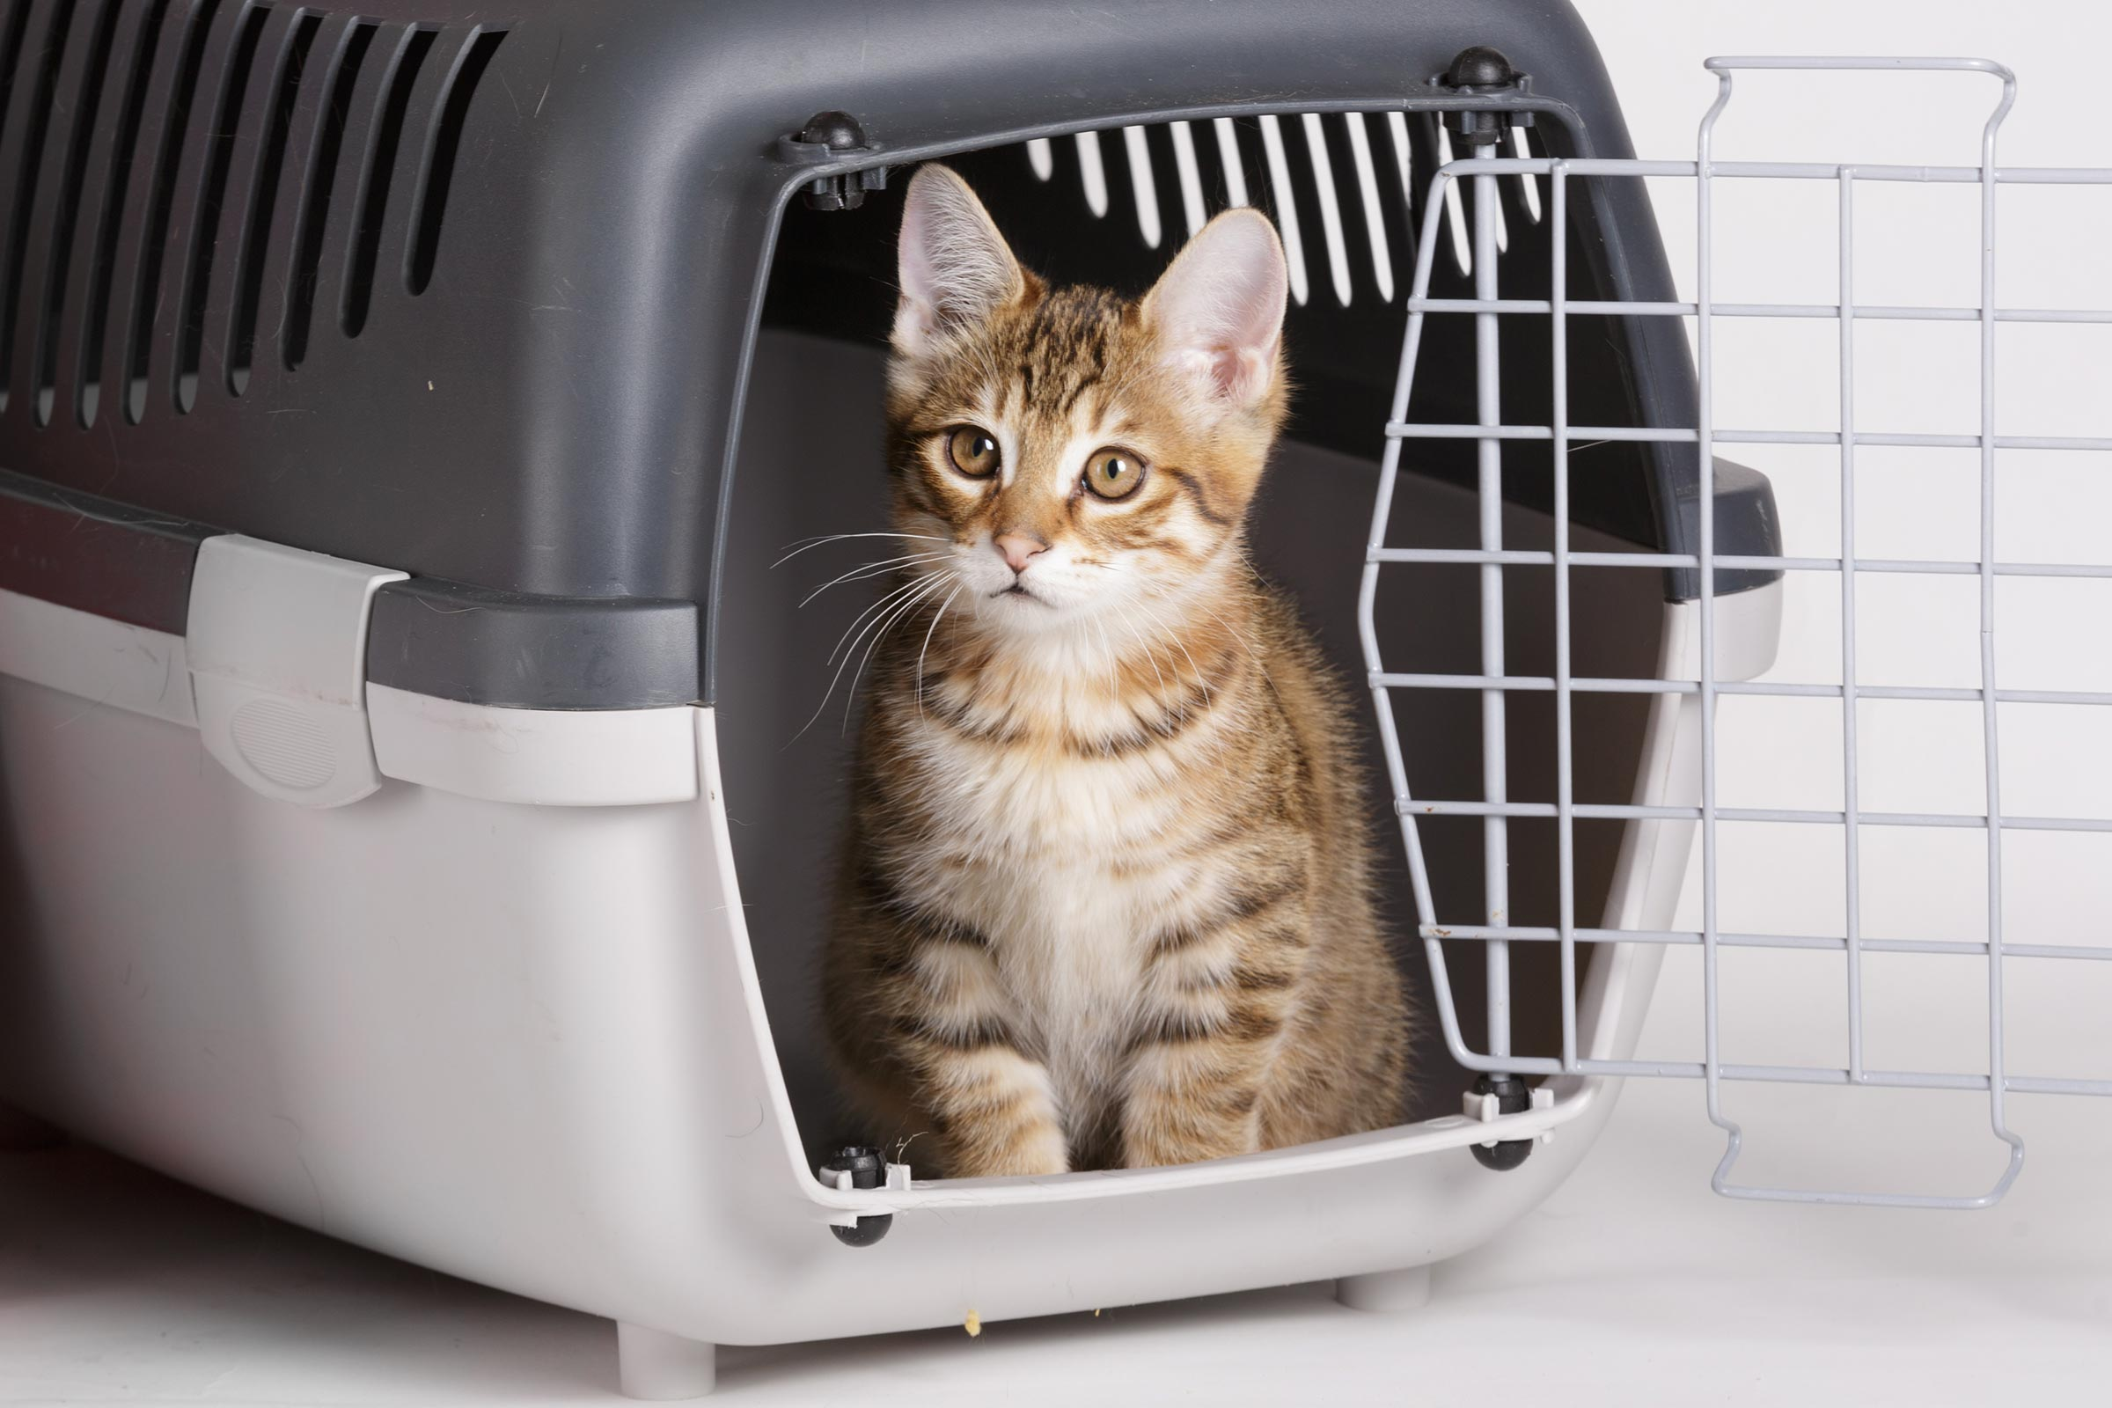
Grab List & Kit For Pets
Generalized List
Extra Food (on-hand)
Water
Bowls
Medicine
Identification & Photos
Microchipped, collars, tags
Carrier/crate
Leashes
Toys, comfort items
Bedding (blankets, hidebox, straw, etc)
Emergency Contacts
People & Vet & could add daycare too!
Paperwork (vaccines, health information)
First aid kit

Slide 12
Grab List & Kit For Pets
Generalized List
Extra Food (on-hand)
Water
Bowls
Medicine
Identification & Photos
Microchipped, collars, tags
Carrier/crate
Leashes
Toys, comfort items
Bedding (blankets, hidebox, straw, etc)
Emergency Contacts
People & Vet & could add daycare too!
Paperwork (vaccines, health information)
First aid kit
Additional Considerations
Animal specific
Litter
Filtration drops
Tank needs
Trailers
Catch net

Slide 13
Make a Plan For Your Pet
Build a Kit
Build a grab list & kit
Document
Write instructions on how to evacuate your animal.
Share
Share with neighbors
Write habits, behaviors, and tips about your animal
Take / print pictures of your animal
Share with Friends / Family
Discuss what would happen to your animal with your family

Slide 14
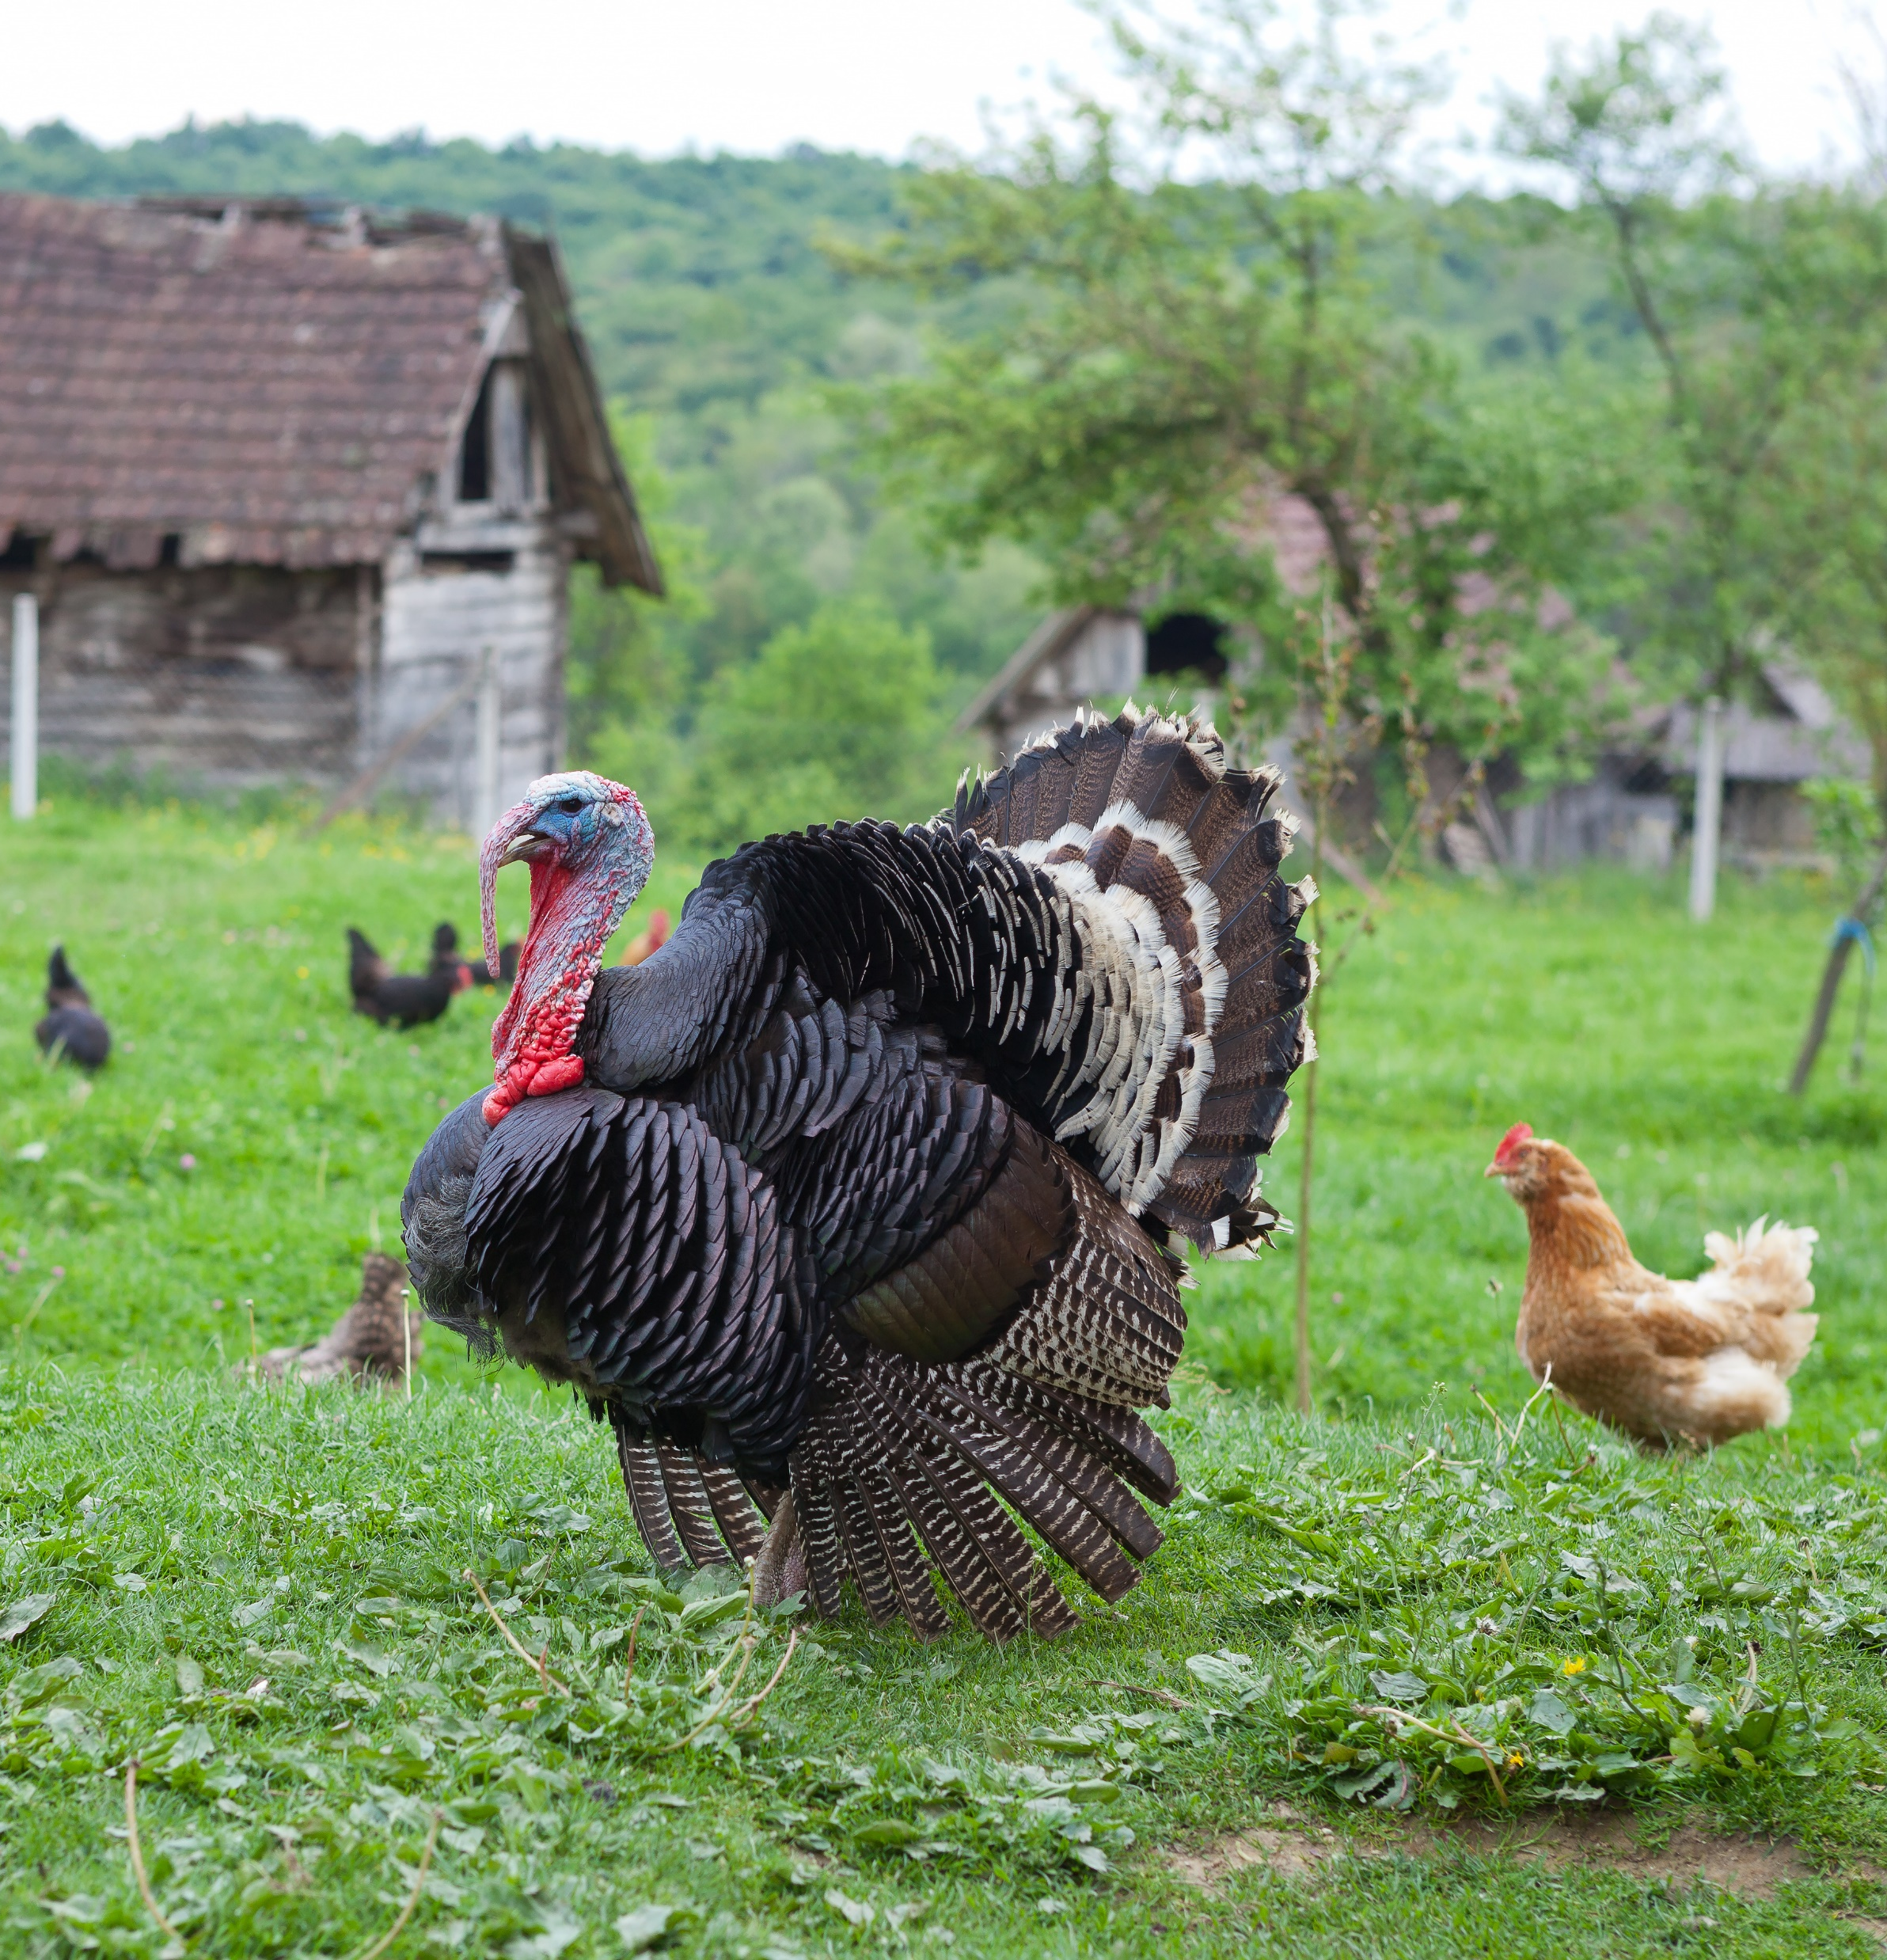
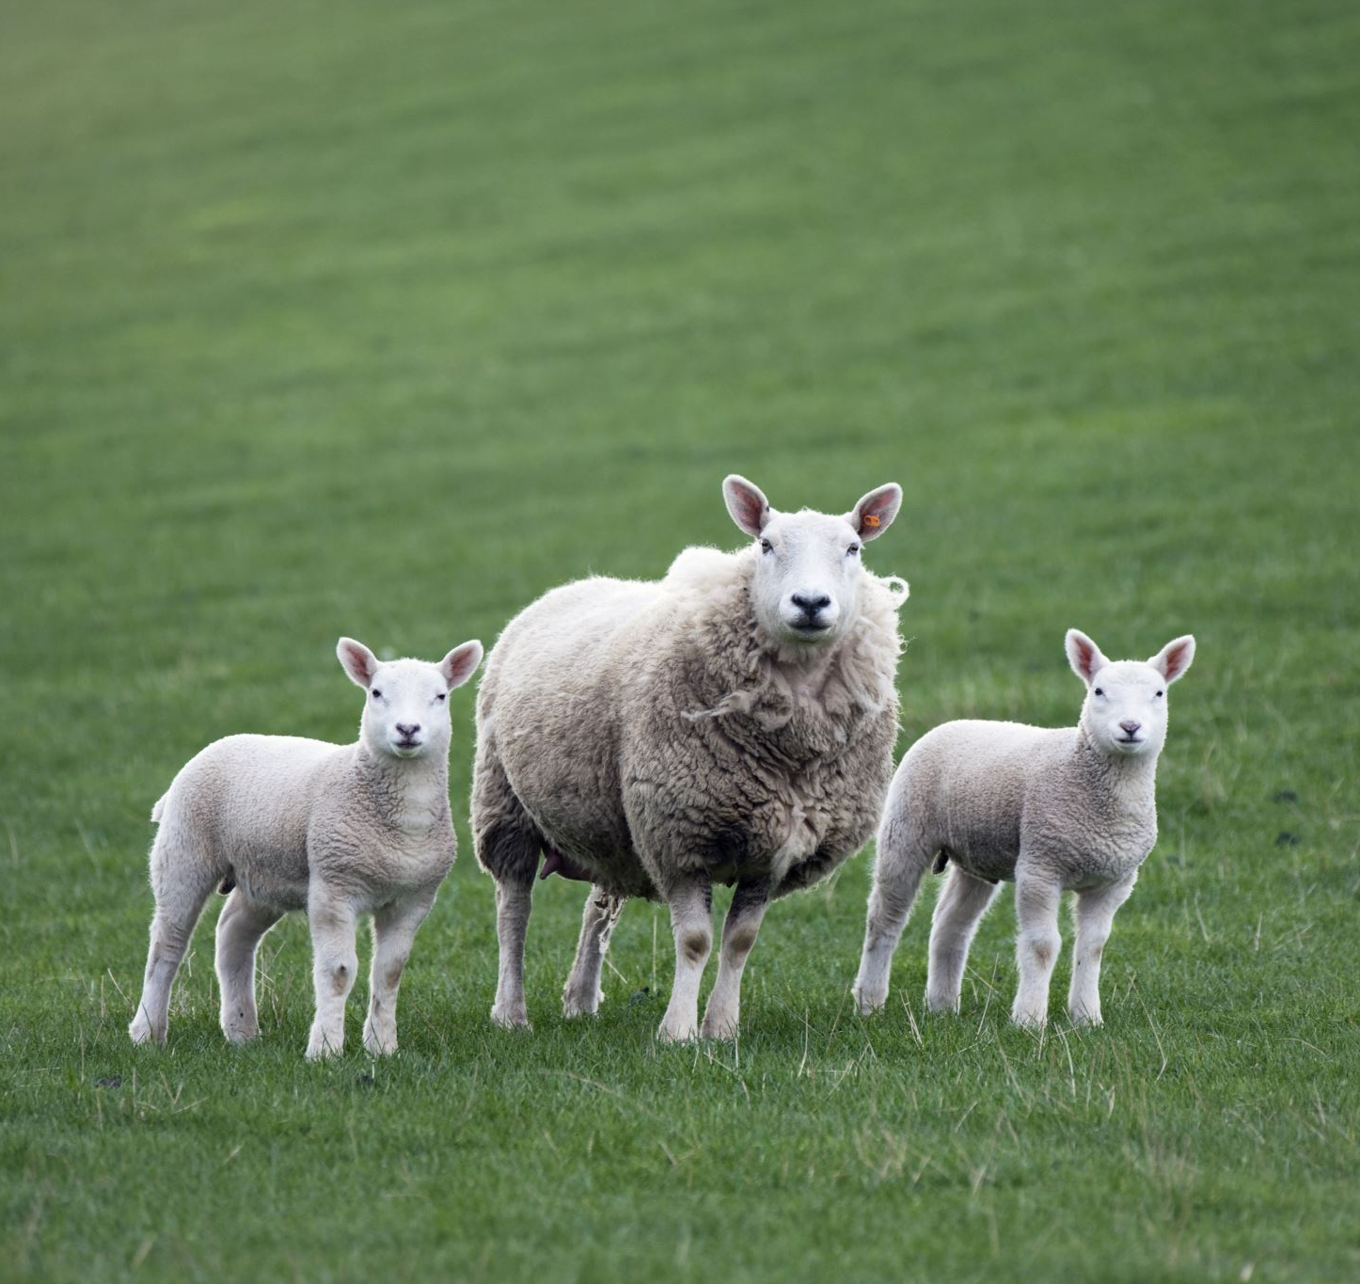
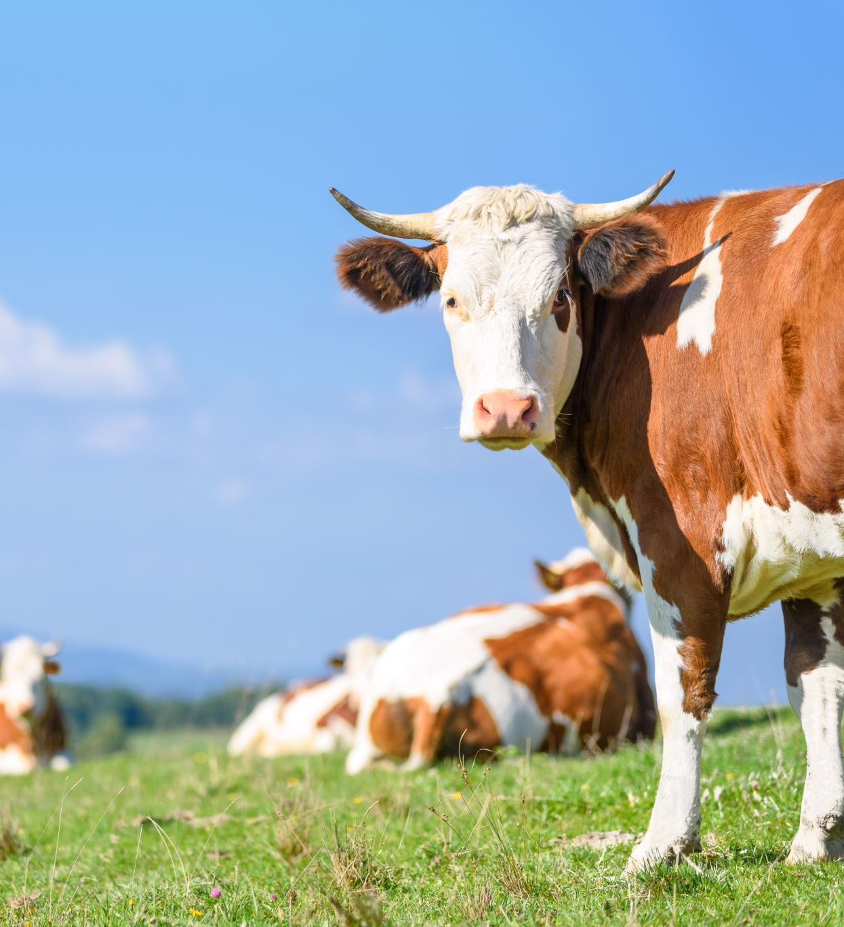
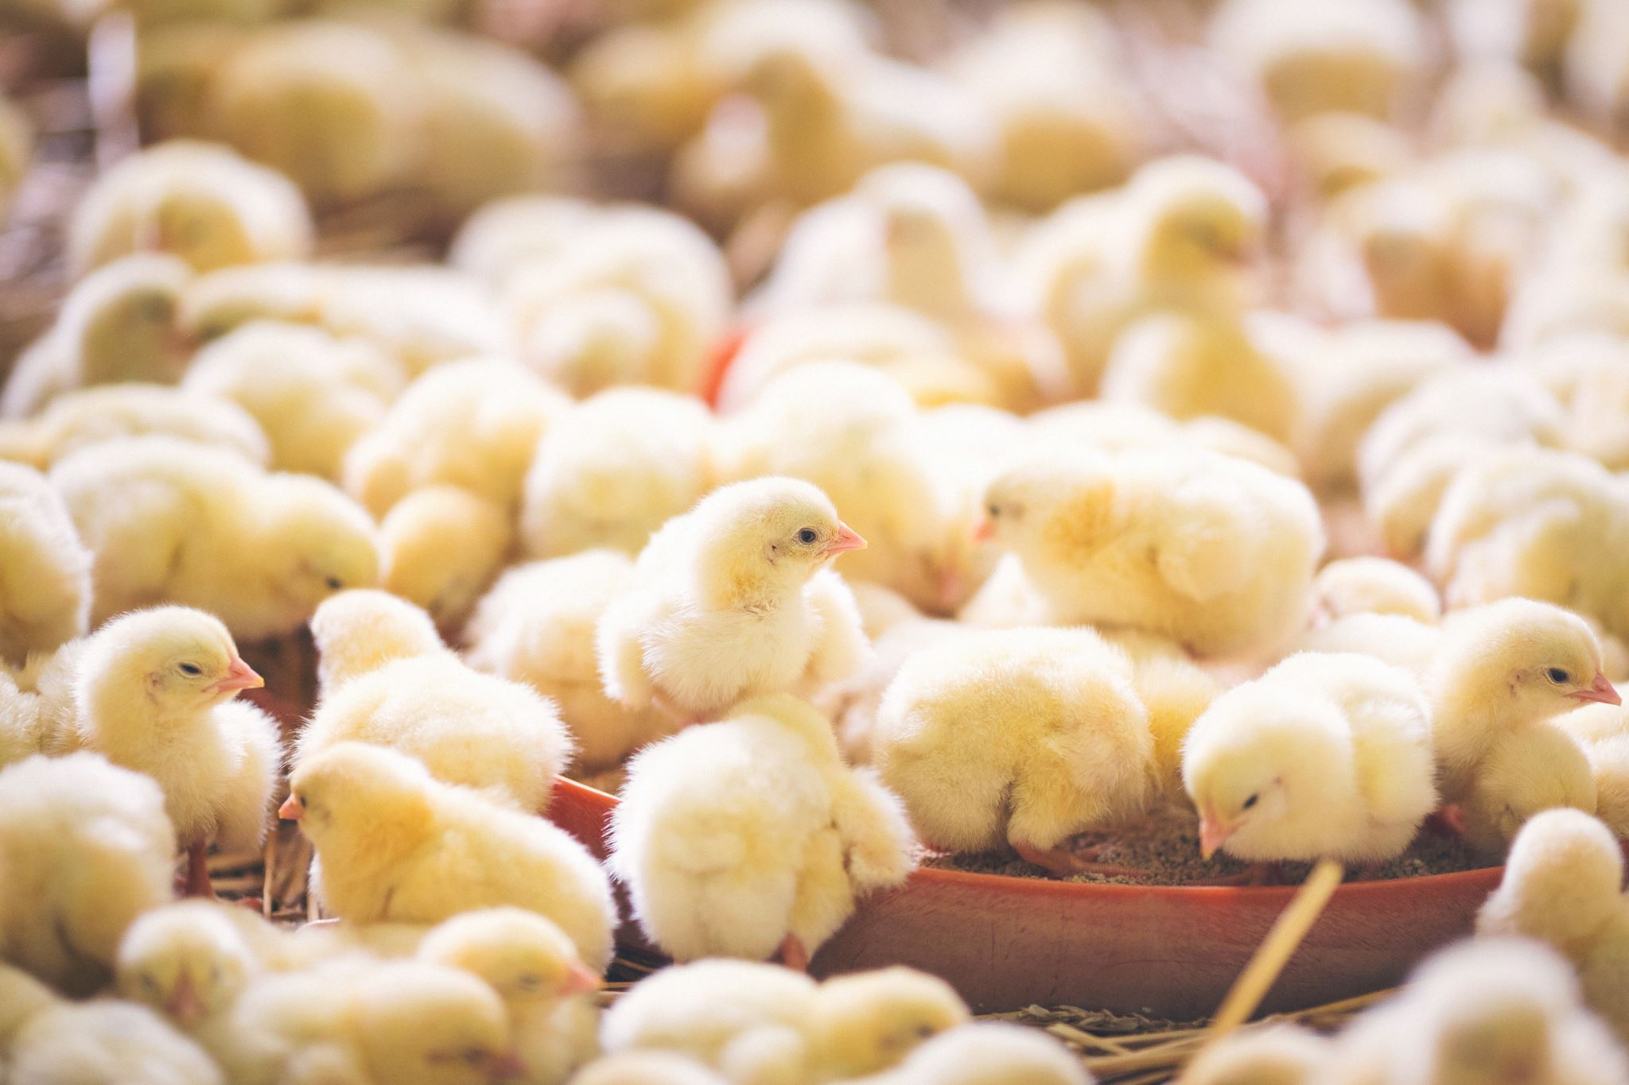
What about Livestock & Farm Animals?

Slide 15
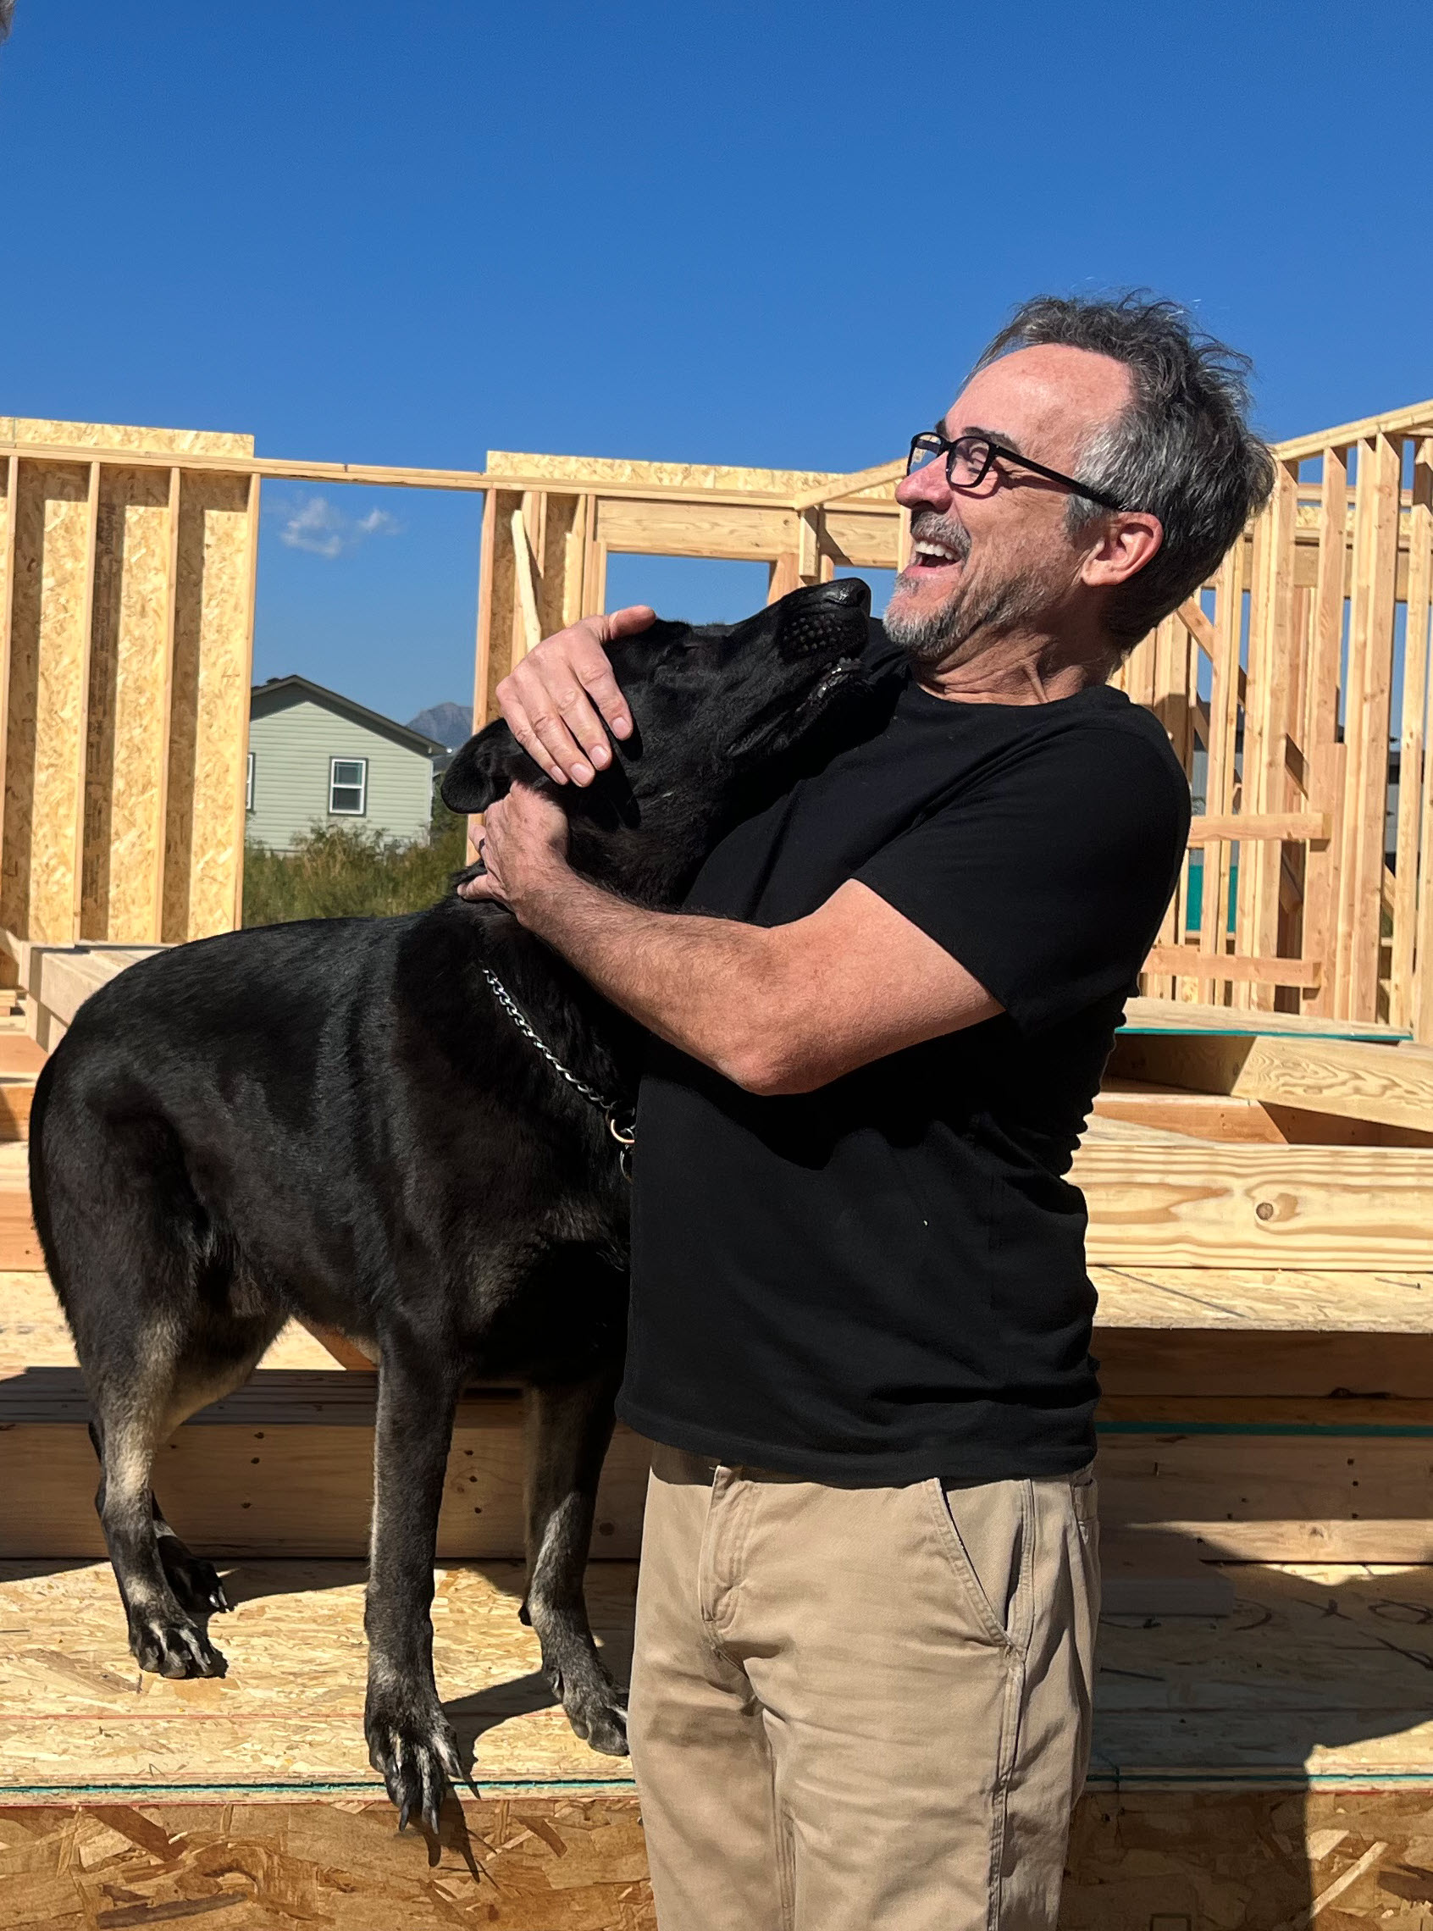
Do Your Pets Know Your Neighbors?

Slide 16
Additional Resources (click on the icon)

Slide 17
Contact Us!
Kiana Freeman
David Crawford
Email: kfreeman@louisvilleco.gov
Phone: 720.990.3369
Email: davidc@ahnow.org
Phone: 303-324-5861

Slide 18
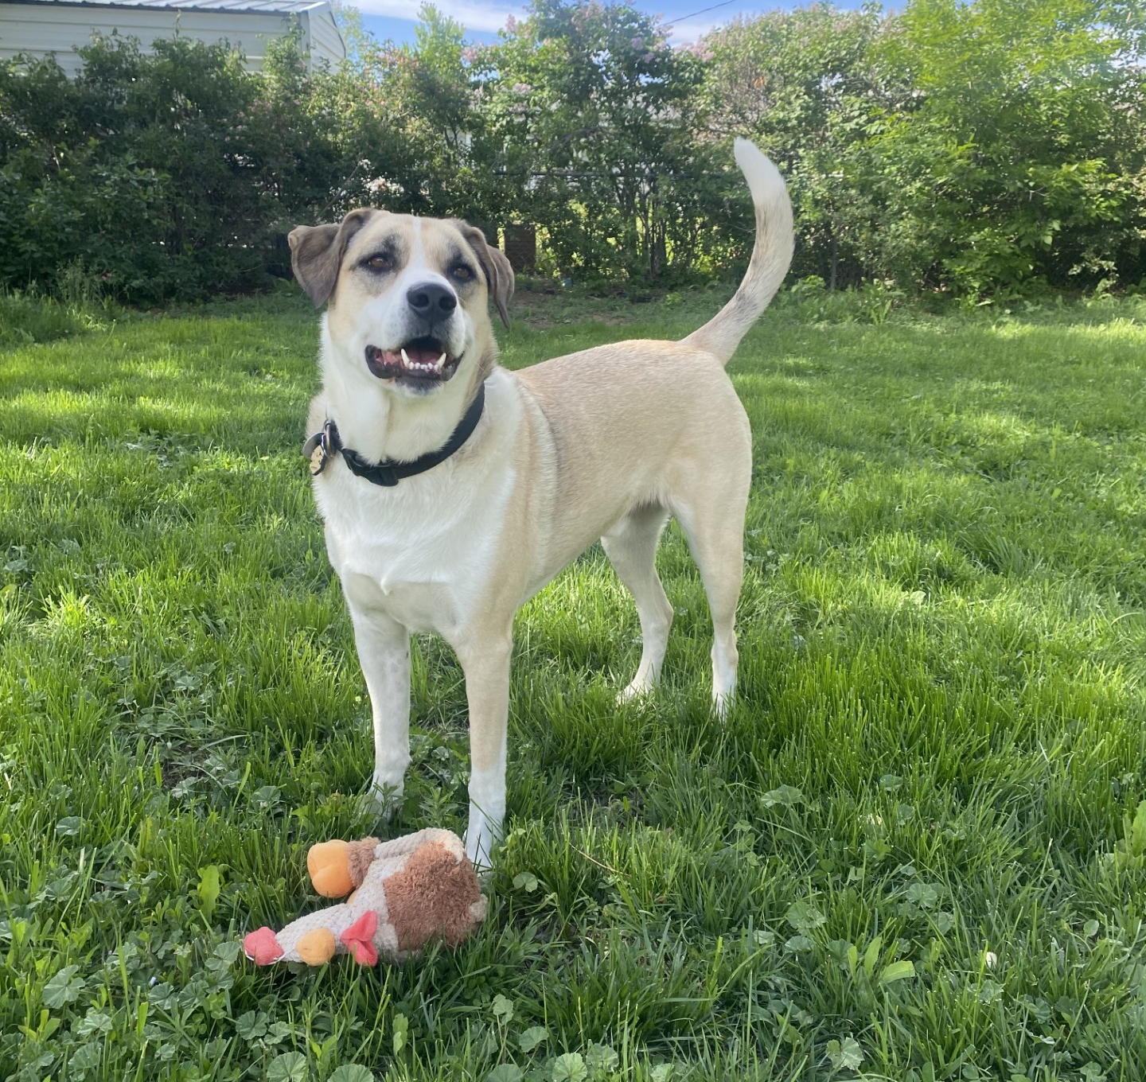
Questions?

