Slide 1
Access and Functional Needs Disaster Preparedness
Craig Towler (Community Outreach Coordinator for Center for People with Disabilities)
and
Taylor Smith (Disaster Recovery Specialist for Town of Superior)
Notes:
Introduce ourselves

Slide 2
What is Access and Functional Needs?
Notes:
Interactive Dialogue for the audience - Taylor

Slide 3
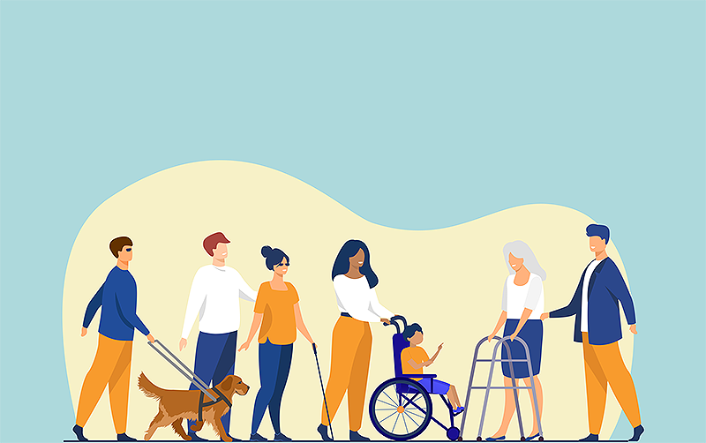
Whole Community Inclusion
People from diverse cultures, races, and nation of origin
Children
Elderly Population
Individuals with short term and long-term disabilities
Pregnant individuals, late stage pregnancy
Living in institutionalized settings
Notes:
Specific overview of what AFN is- Taylor

Slide 4
Low income/ homeless
Individuals with pharmacological dependency
Chronic conditions/ injuries
Limited English proficiency
Transportation disadvantaged
Expanded Disability definition:
includes the broadest group of people who benefit from physical, communication, and program access; it includes people who have access and functional needs, may or may not meet civil rights law definitions, are part of other diverse and sometimes conflicting definitions of disability.
Notes:
Taylor

Slide 5
Tips for Preparedness
Stay Informed
Know your hazards in your area
Make a plan
Grab list/ go bag items
Notes:
Basic outline for general preparedness- Taylor

Slide 6
Stay Informed
Sign up for BoCo Alert
NOAA Weather Radio
(Radio Frequencies 162.550)
Personal Risk Assessment
Notes:
Taylor

Slide 7
Where do you typically receive information when there is a disaster?
Landline phone
Cell phone - call or text
TV or Radio
App
Notes:
Open up how lifelines/ resources can be affected- Taylor

Slide 8
Dependent on the hazard or emergency happening- many lifelines can be affected such as;
Power
Communication/Technology
Equipment
Transportation
Infrastructure
Access
Notes:
Open up how lifelines/ resources can be affected- Taylor

Slide 9
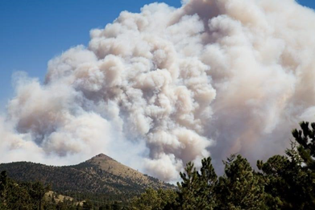
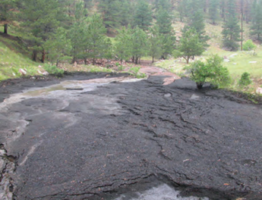
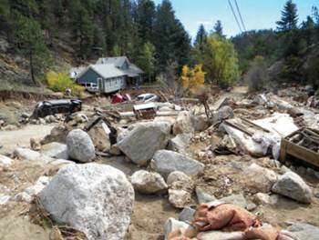
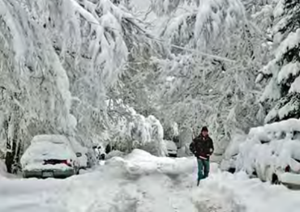
2. Know the hazards in your area
Wildfires
Winter Storms
Red Flag Warnings/ Wind
Thunderstorms/ Lightning
Flooding
Landslides
Drought
Tornado
Notes:
Mention different hazards that have different impacts- Taylor

Slide 10
3. Make a Plan
Create a plan involving your family and close contacts
Communication Cards
Determine a designated meeting point in case of evacuation
Where is the nearest evacuation center
Make sure your plan accounts for your specific needs
Transportation needs
Give yourself extra time to mobilize if needed before an actual order of evacuation
Start during pre-evacuation
Notes:
Every person’s plan is going to be different- Craig

Slide 11
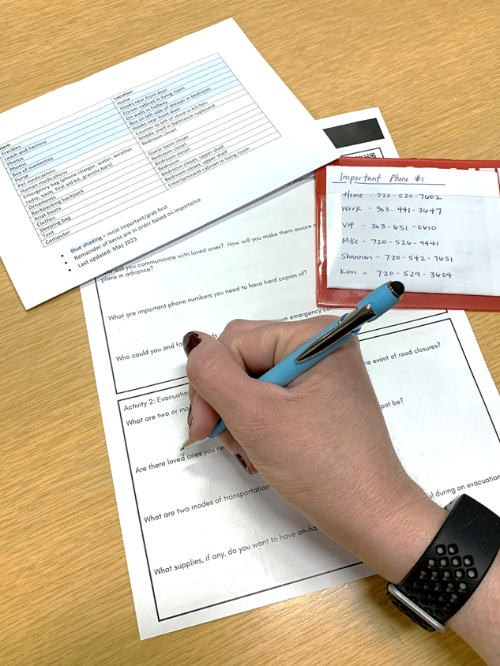
Creating Your
Personal Plan
Communication
Evacuation or sheltering-in-place
Grab list
Notes:
Every person’s plan is going to be different- Craig

Slide 12
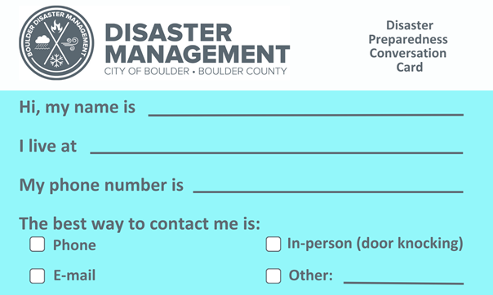
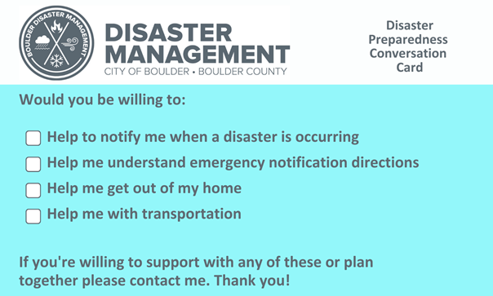
Communication
Pre-planning
Conversation cards
Important contact information
Where to get information
Notes:
Every person’s plan is going to be different- Craig

Slide 13
Evacuations
Transportation
Garages
Routes
When to leave
Notes:
Discuss between the difference of a grab list versus a go bag: based on individual’s capability and resources- Craig

Slide 14
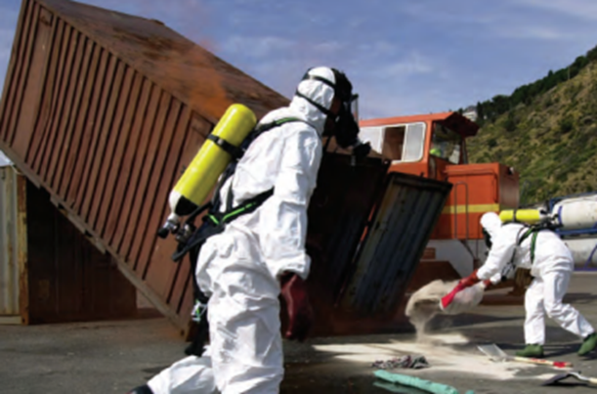
Sheltering -in- Place
Stay indoors
Resources
Food
Water
Power
Notes:
Discuss between the difference of a grab list versus a go bag: based on individual’s capability and resources- Craig

Slide 15
4. Grab list/ Go bag
Going to look different for every individual
Necessities that help you function daily
Sentimental/ valuable items
Medications/ equipment/ pets
Notes:
Discuss between the difference of a grab list versus a go bag: based on individual’s capability and resources- Craig

Slide 16
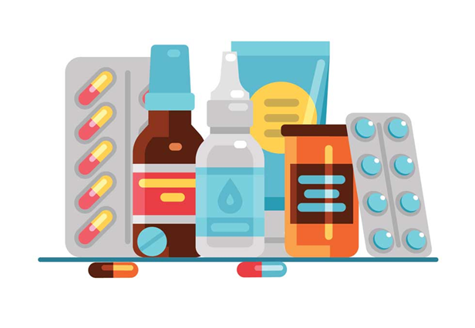
Grab list/ Go bag Tips for Medications
Keep a list of your prescription medicines. Include information about your diagnosis, dosage, frequency, medical supply needs and allergies.
Store extra nonprescription drugs, like pain and fever relievers, antihistamines and antidiarrheal medicines.
Have a cooler and chemical ice packs available to chill medicines that need to be refrigerated.
Notes:
Discuss between the difference of a grab list versus a go bag: based on individual’s capability and resources- Craig

Slide 17
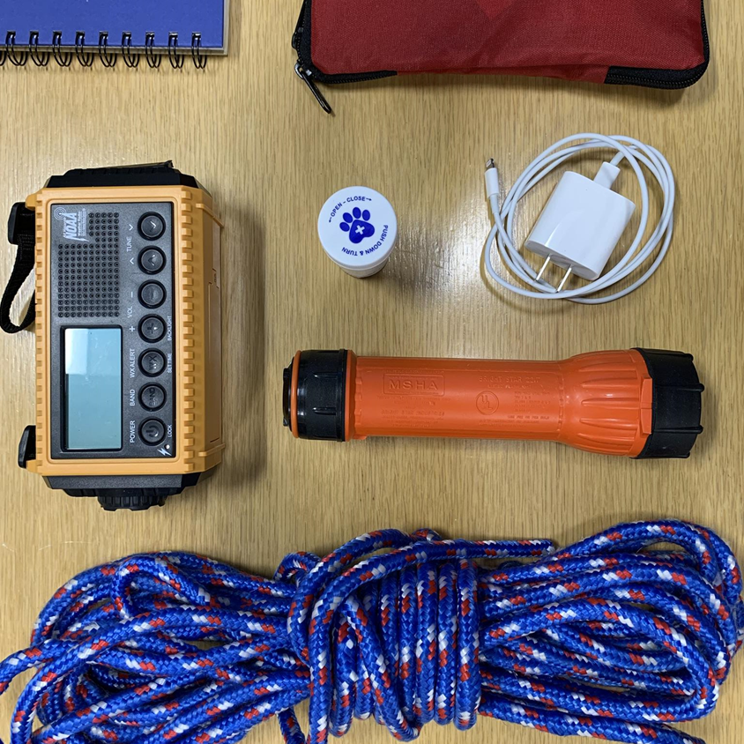
Grab list/ Go bag Tips for People Who are Deaf or Hard of Hearing
Weather radio (with text display and a flashing alert)
Extra hearing-aid batteries
Pen and paper (in case you have to communicate with someone who does not know sign language)
Battery operated lantern to enable communication by sign language or lip reading, especially when the electricity is out and it’s dark.
Notes:
Discuss between the difference of a grab list versus a go bag: based on individual’s capability and resources- Craig

Slide 18
Grab list/ Go bag Tips for People Who are Blind or Have Low Vision
Mark emergency supplies with Braille labels or large print. Keep a list of your emergency supplies and where you bought them on a portable flash drive or make an audio file that is kept in a safe place where you can access it.
Keep communication devices for your particular needs, such as a Braille or deaf-blind communications device as part of your emergency supply kit.
Notes:
Discuss between the difference of a grab list versus a go bag: based on individual’s capability and resources- Craig

Slide 19
Grab list/ Go bag Tips for People with an Added Mobility Need
If you use a power wheelchair have a lightweight manual chair available as a backup if possible.
Show others how to assemble, disassemble and operate your wheelchair.
Purchase an extra battery for a power wheelchair or other battery-operated medical or assistive technology devices. If you can't purchase an extra battery, find out what agencies, organizations or local charitable groups can help you buy one. Keep extra batteries charged at all times.
Notes:
Discuss between the difference of a grab list versus a go bag: based on individual’s capability and resources- Craig

Slide 20
Grab list/ Go bag Tips for People with an Added Mobility Need Continued
Consider keeping a patch kit or can of sealant for flat tires and/or extra inner tube if wheelchair or scooter is not puncture proof.
Keep an extra mobility device such as a cane or walker if you use one.
Keep a portable air pump for wheelchair tires.
If you use a seat cushion to protect your skin or maintain your balance and you must evacuate, consider keeping an extra cushion on hand.
Communicate with neighbors who can assist you if you need to evacuate the building.
Notes:
Discuss between the difference of a grab list versus a go bag: based on individual’s capability and resources- Craig

Slide 21
Build a Kit for Your Pet
Food. Keep several days’ supply of food in an airtight, waterproof container.
Water. Store a water bowl and several days’ supply of water.
Medicine. Keep an extra supply of the medicine your pet takes on a regular basis in a waterproof container.
First aid kit. Talk to your veterinarian about what is most appropriate for your pet’s emergency medical needs.
Notes:
Discuss between the difference of a grab list versus a go bag: based on individual’s capability and resources- Craig

Slide 22
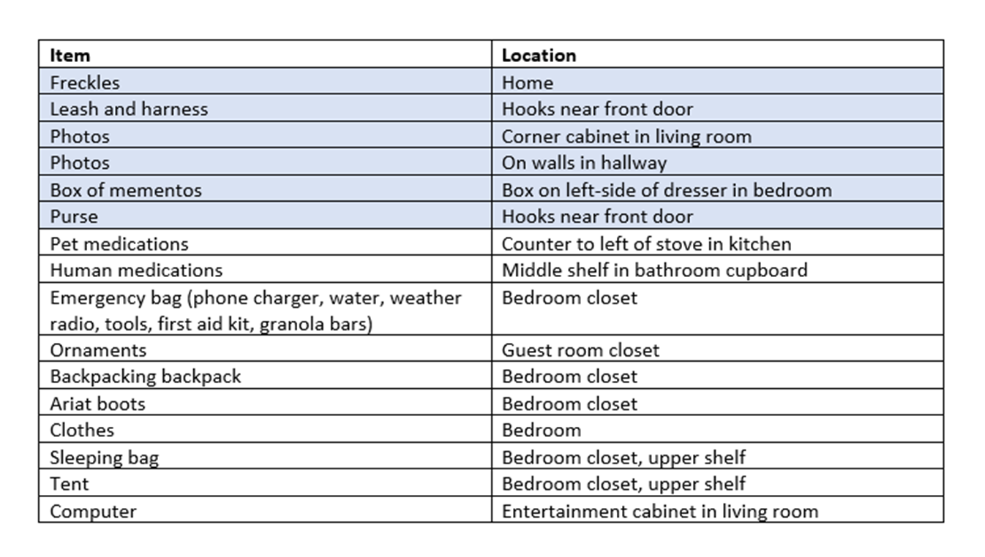
Notes:
Discuss between the difference of a grab list versus a go bag: based on individual’s capability and resources- Craig

Slide 23
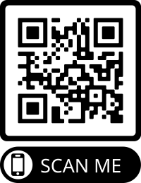
Center for Inclusive Design and Engineering: Surviving In Place
Colorado‘s Medicaid Programs:
Battery Backup Program
Pre-Assembled Go Kit
Notes:
Taylor

Slide 24
Contact Information
Center for People With Disabilities:
www.cpwd.org
info@cpwd.org
Craig Towler
craig@cpwd.org
(303) 442-8662
Notes:
mention caregiver resources- Craig

